Slide 1
Pediatric Procedural Sedation in Europe Quo Vadis?
Jurgen C. de graaaff
ErasmusMC University Medical Center Rotterdam

Slide 2
Multidisciplinary
Pediatricians, intensivists, emergency physician, neonatologists, anesthesiologists, gastroenterologists, pharmacologists, psychologists, dentists, physician assistants, nurses, PSA, anesthetic nurses
Physicians, nurses, politicians, press, parents!
23 countries

Slide 4
Empathy and Empathic blindness Bénédicte Lombart & Sophie Verbeek

Slide 9
The Biology of Empathy Frans de Waal

Slide 13
Non-Verbal Communication in the patient-professional relationship Judith Hall

Slide 15
Placebo and Nocebo effects Fabrizio Benedetti

Slide 17
Making a human connection: establishing trust with children Baruch Krauss

Slide 20
A Parent’s quest for procedural comfort Vera Tomassen

Slide 25
Analgesia for Common Procedures in Children Amy Baxter

Slide 28
Lessons from the dental chair Rick van der Pas

Slide 29
Rights based standards for children undergoing clinical procedures: an international collaborative good practice statement Lucy Bray

Slide 31
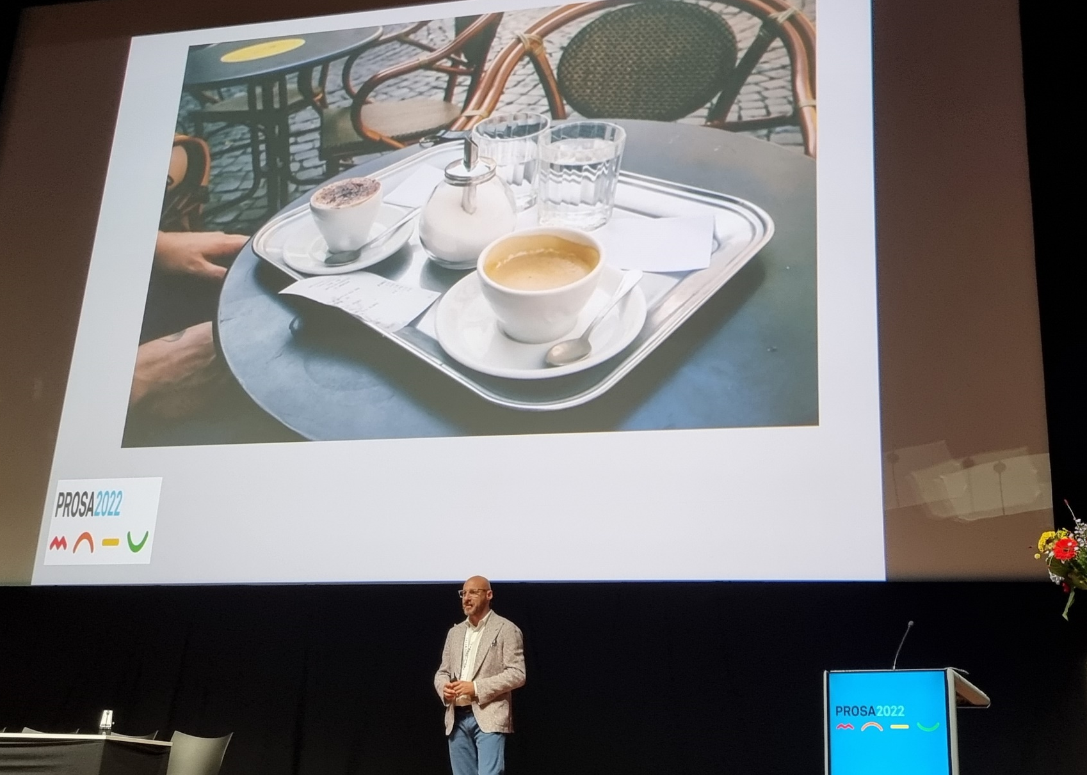
Procedural Distress and Comfort in Neonates Gabriele Cont

Slide 34
Long-Term consequences of procedural pain at the young age Anna Taddio

Slide 37
Procedural Sedation and Analgesia in the (Very) Young Children – Practical Pharmacology Karel Allegaert

Slide 41
Safety of Procedural Sedatives in young children: is neurotoxicity an issue? Jurgen de Graaff

Slide 42
Procedural Sedation and the Pediatric Airway: interactions and precautions Mohamed Mahmoud

Slide 45
Pre-sedation fasting: an update of the evidence and the new ICAPS guidelines Mark Roback

Slide 48
Risk factors and adverse events in pediatric procedural sedation Maala Bhatt

Slide 51
Nitrous Oxide: Angel or Devil Daniel Annequin

Slide 53
PSA Practice patterns in European Emergency Care Units: Challenges & Opportunities Cyril Sahyoun

Slide 55
Training pediatric ED staff in procedural sedation: achievements and lessons learnt Silvia Bressan

Slide 56
Trust me, I am a trained sedation provider! Incorporating Entrustable Professional Activities into a pediatric sedation curriculum for specialized nurses Marga van Eck-Smaling

Slide 57
Pediatric Procedural Sedation in Europe Quo Vadis?

Slide 58
4
Open for emotions of children
Overcome our own medical urge: do the best suitable for the child?
Re-evaluate need for:
Contact & hospital admission
Intervention: temperate, blood sampling!
Multidisciplinary approach!
Specialists: Surgeons?
Anesthesiologists: come out of OR
Physicians, nurses, politicians, press, parents!
Children?
Local multidisciplinary approach
More countries!
All & Piet keep on going, work together!

Slide 59
The human factor Piet Leroy

