Slide 1

Safety of Procedural Sedatives in young children:
Is neurotoxicity an issue?
Jurgen C. de graaaff
Associate prof. Paediatric Anesthesia
ErasmusMC University Medical Center Rotterdam

Slide 2
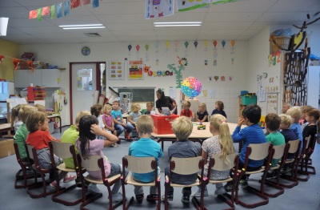
How often?
1 out of 7 children had anesthesia < 3 years
Shi et al. Ped Anesth, 2018: 513-519

Slide 3

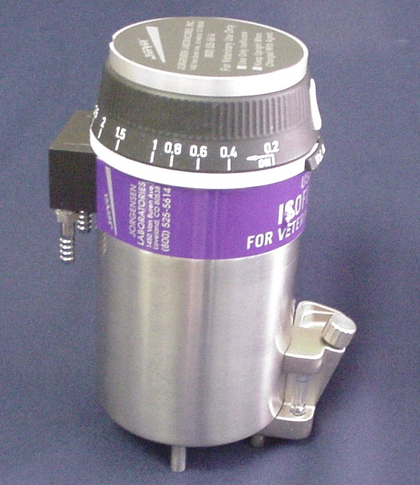
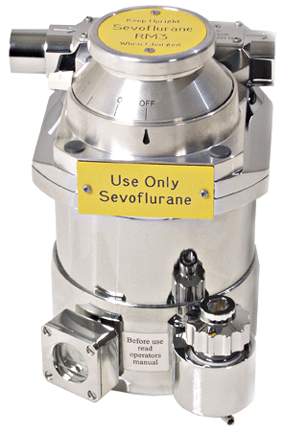
Effect of anesthesia on long term?
Is anaesthesia toxic for brain?
?

Slide 4
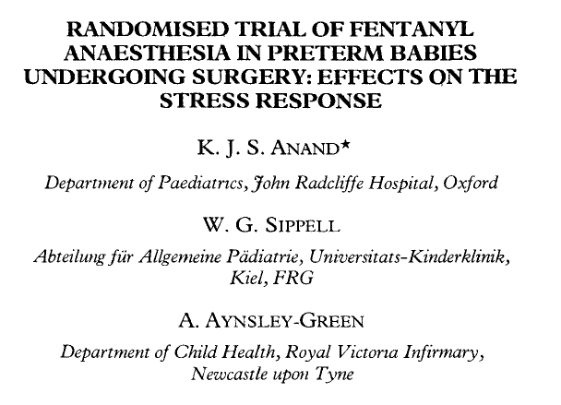
Lancet, Jan 31, 1987

Slide 5
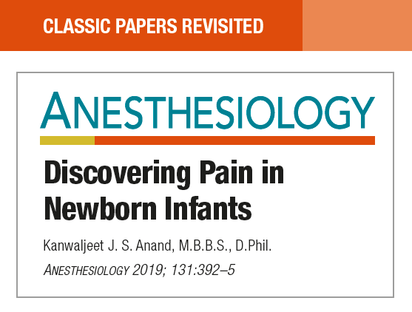


Slide 6
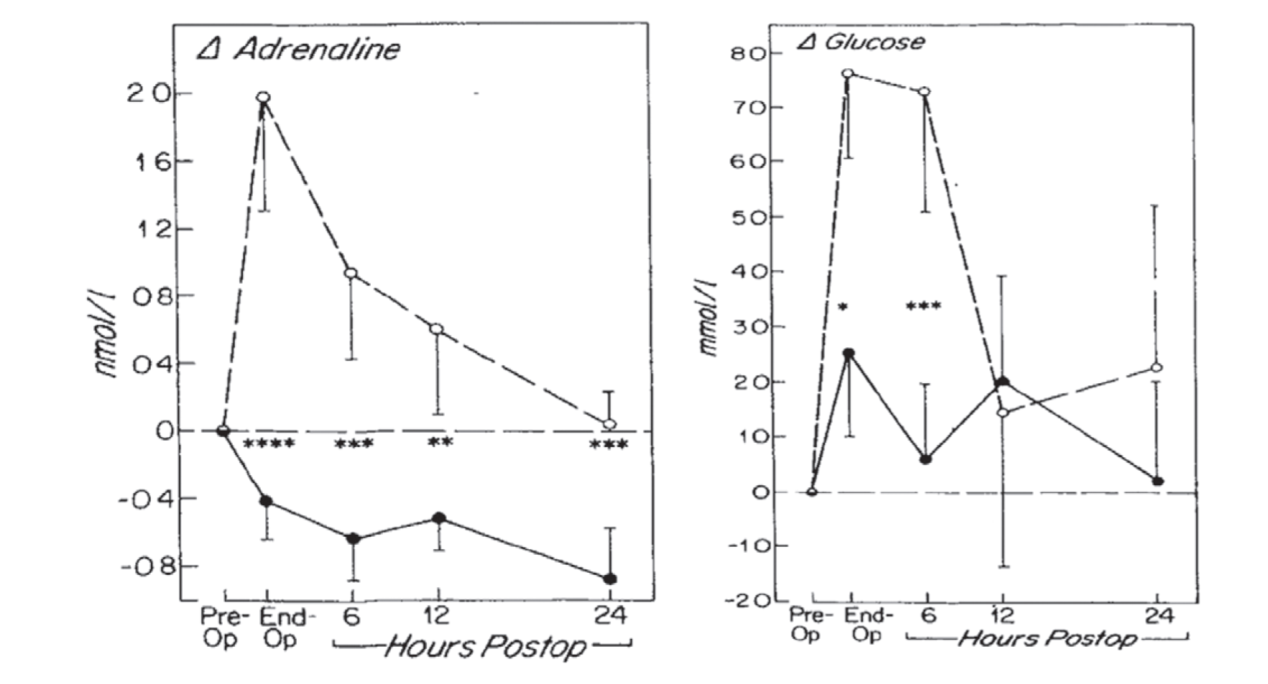
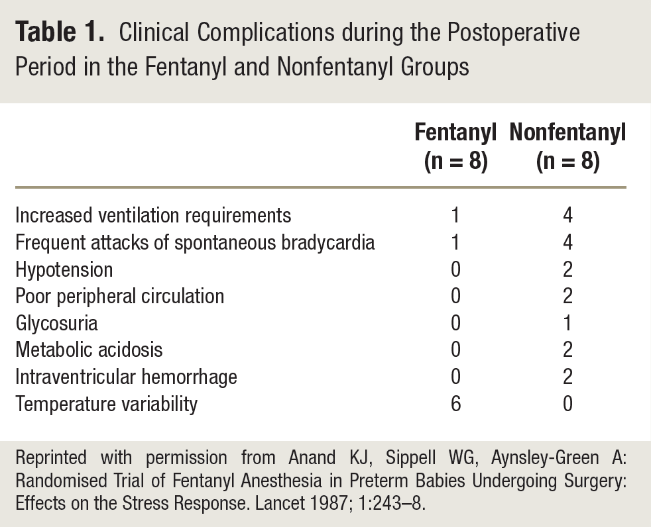
Randomized clinical trial: ductus ligation
No opioids (NO + mus vs. + opioids (fentanyl)
Anand Lancet 1987

Slide 7
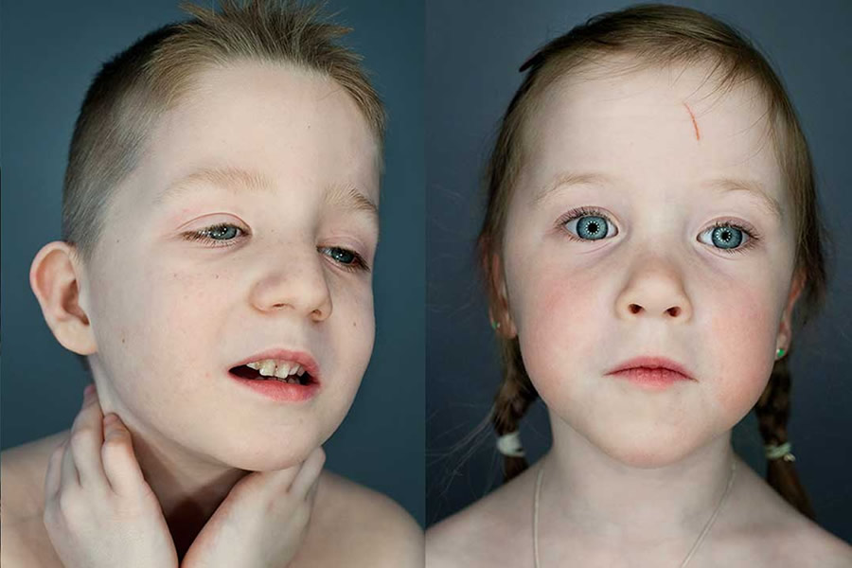
Established Neurotoxins
Alcohol Fetal alcohol syndrome
www.fasproject.nl
Creeley and Olney Anesth Analg 2010;110 442-8

Slide 8
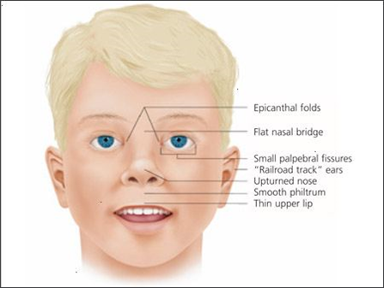
Established Neurotoxins
Alcohol Fetal alcohol syndrome
Antiepileptic drugs Fetal malformations
  Phenyetoin Developmental delay
  Phenobarbital Microcephaly
  Benzodiazepine

Slide 9
Established Neurotoxins
Alcohol Fetal alcohol syndrome
Antiepileptic drugs Fetal malformations
  Phenyetoin Developmental delay
  Phenobarbital Microcephaly
  Benzodiazepine
Anesthetic drugs
  Nitrous oxide
  Ketamine
  Isoflurane/Sevoflurane
  Propofol
  Midazolam
?
Creeley and Olney Anesth Analg 2010;110 442-8

Slide 10
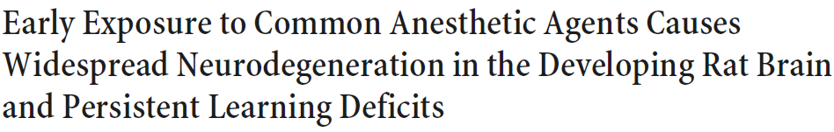
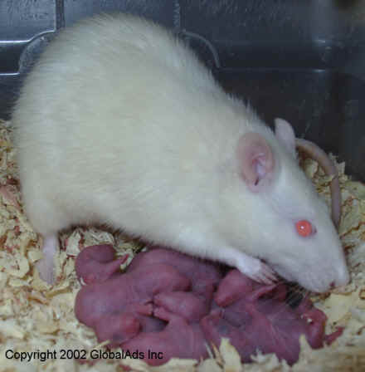
Neurotoxicity: Animal models
Triple cocktail (P7 rat pups)
  Midazolam, Isoflurane, NO
Jevtovic-Todorovic J Neurosci 2003

Slide 11
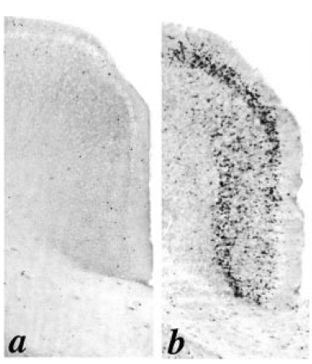
Neurotoxicity: Animal models
Triple cocktail (P7 rat pups)
  Midazolam, Isoflurane, NO
Histologic changes:
  Neurodegeneration: apoptosis
  Decrease neuronal sprouting
Jevtovic-Todorovic J Neurosci 2003

Slide 12
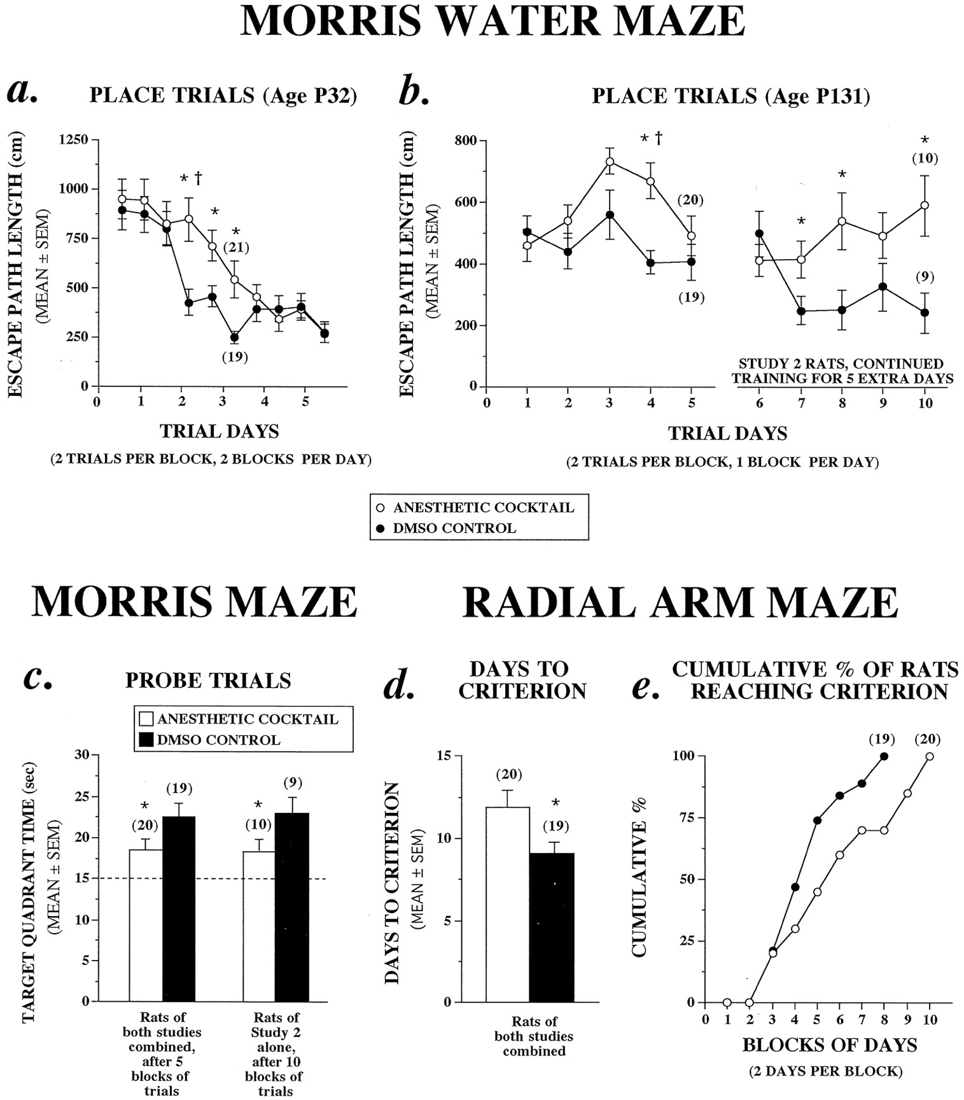
Neurotoxicity: Animal models
Triple cocktail (P7 rat pups)
  Midazolam, Isoflurane, NO
Histologic changes:
  Neurodegeneration: apoptosis
  Decrease neuronal sprouting
Cognitive dysfunctions on long term:
  Memory & learning impairment
Jevtovic-Todorovic J Neurosci 2003

Slide 13
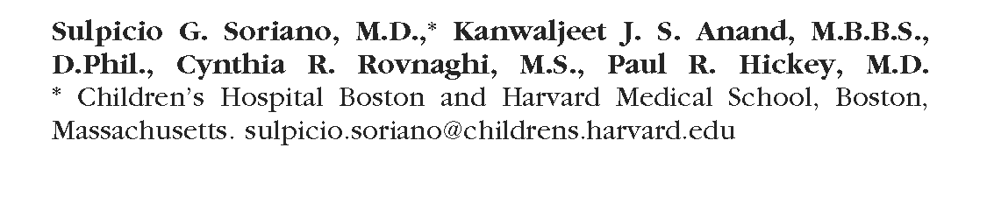
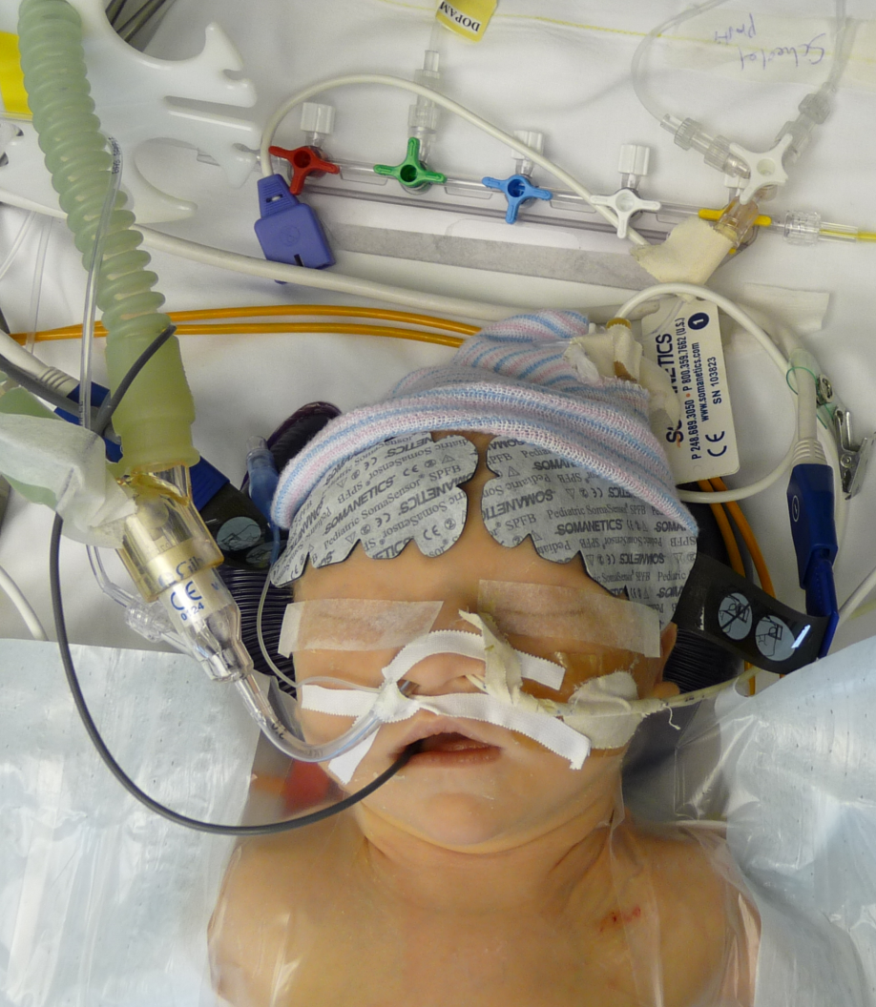

Slide 14
Comment: Humans are not rats!
Problem with rodent experimental paradigm
Duration exposure to drugs
  7 rat days ≅ 27 human months
  6 hour anesthesia ≅ 1 month
Lack of precise physiological monitoring
  High etCO2
  End-organ perfusion
  Varying anesthetic depth
    Target-controlled infusions
    MAC values
Interspecies variation
  Dose-response
  Drug metabolism
  Peak susceptibility

Slide 15
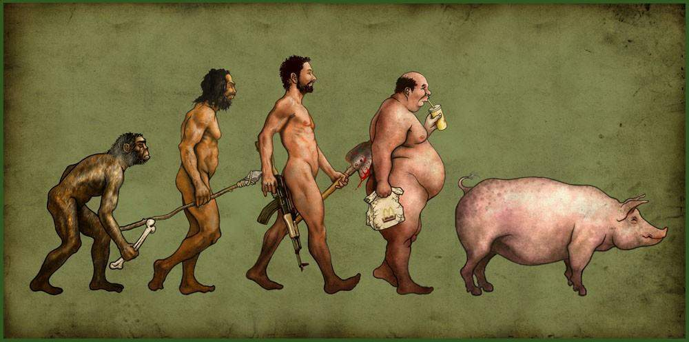

Slide 16
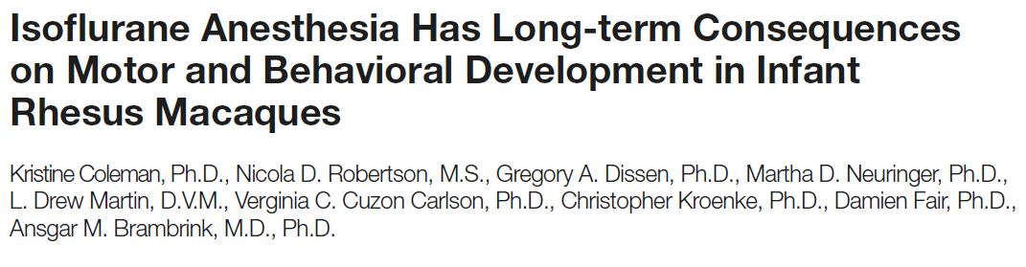
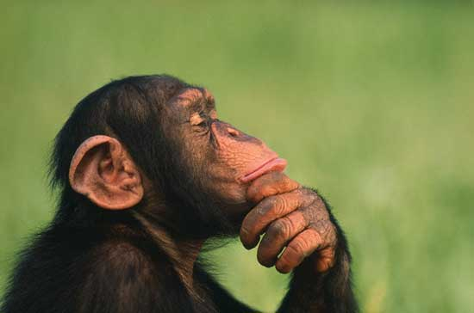
Anaesthesia protocol
  Gentle facemask induction,
  Intubation & ventilation
  Isoflurane: ET= 0.7 to 1.5 vol%
  Full monitoring vital parameters:
    HR/ECG, Sat, BP, resp rate, capnography,
Randomization & Sham procedure: separation mother
Anesthesiology 2010: 112:834 – 41 & 2017; 126:74-84

Slide 17
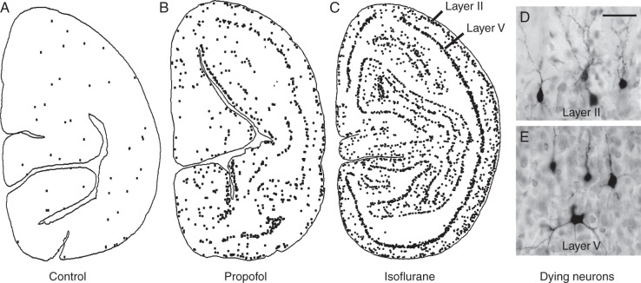
Histologic changes
Creeley BJA 2013 & Brambrink Anesthesiology 2010

Slide 18
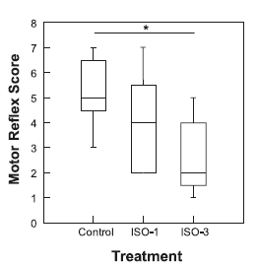
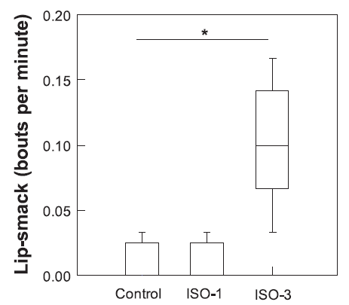
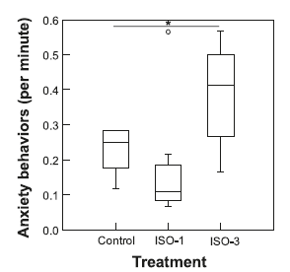
Anesthesiology 2017; 126:74-84
Notes:
ISO-1= 5h isoflurane, ISO-3: 3x5h isoflurane

Slide 19
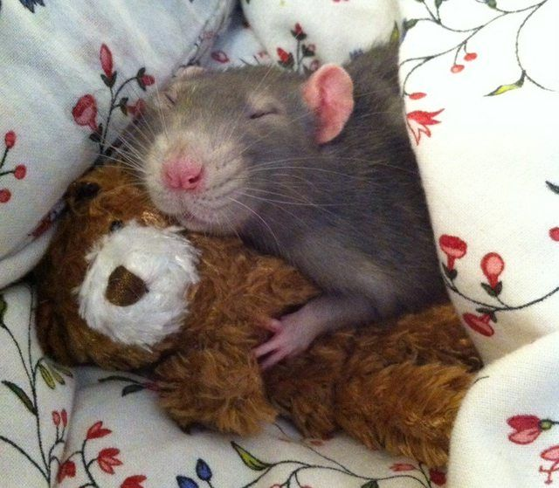

Anesthesia neurotoxicity?
Experimental research:
>1000 publications experimental studies
Rodents
Non-human primates
(Almost) all anesthetic drugs
Dose and duration dependent
Window vulnerability
Period?
  Younger age
  <2-3 year?
Clinical proof: Clinical experiments: impossible
  Cohort studies

Slide 20
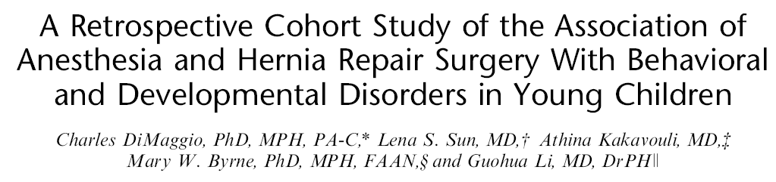
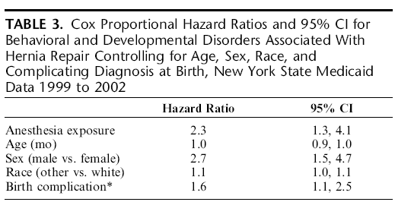
383 inguinal hernia (< 3 yr) vs 5050 matched controls in NY
Behavioral and developmental disorders:
  4,4 % (exposure group) vs 1,2 % (control group)
J Neurosurg Anesthesiol 2009;21:286–291

Slide 21
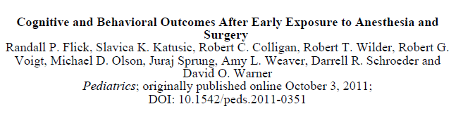
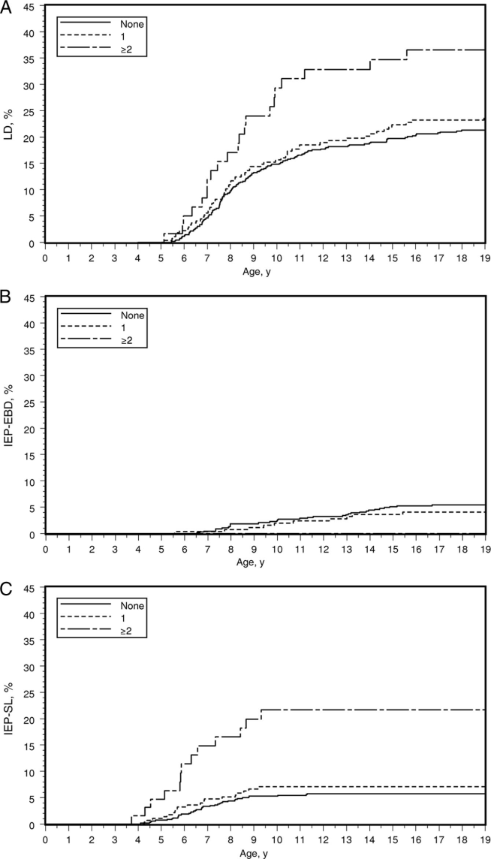

Cohort studie Rochester Minesota
Exposed to anaesthesia n= 350
Controls: n= 700
Multivariate analysis
  Learning disabilities: LD
  Emotional en behaviour disorders: IEP-EBD
  Speak and language: IEP-SL
Multiple exposures:
  LD: HR 2.12 (1.26-3.54)
  IEP-EBI: 0.00
  IEP-SL: 4.76 (2.48 – 9.12)
Anesthesiology 2009 & Pediatrics 2011: 128
LD
IEP-EBD
IEP-SL

Slide 22
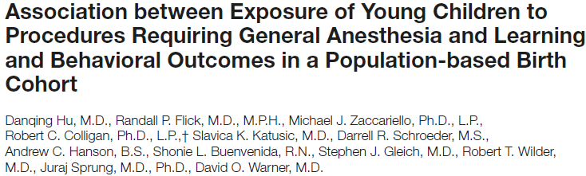
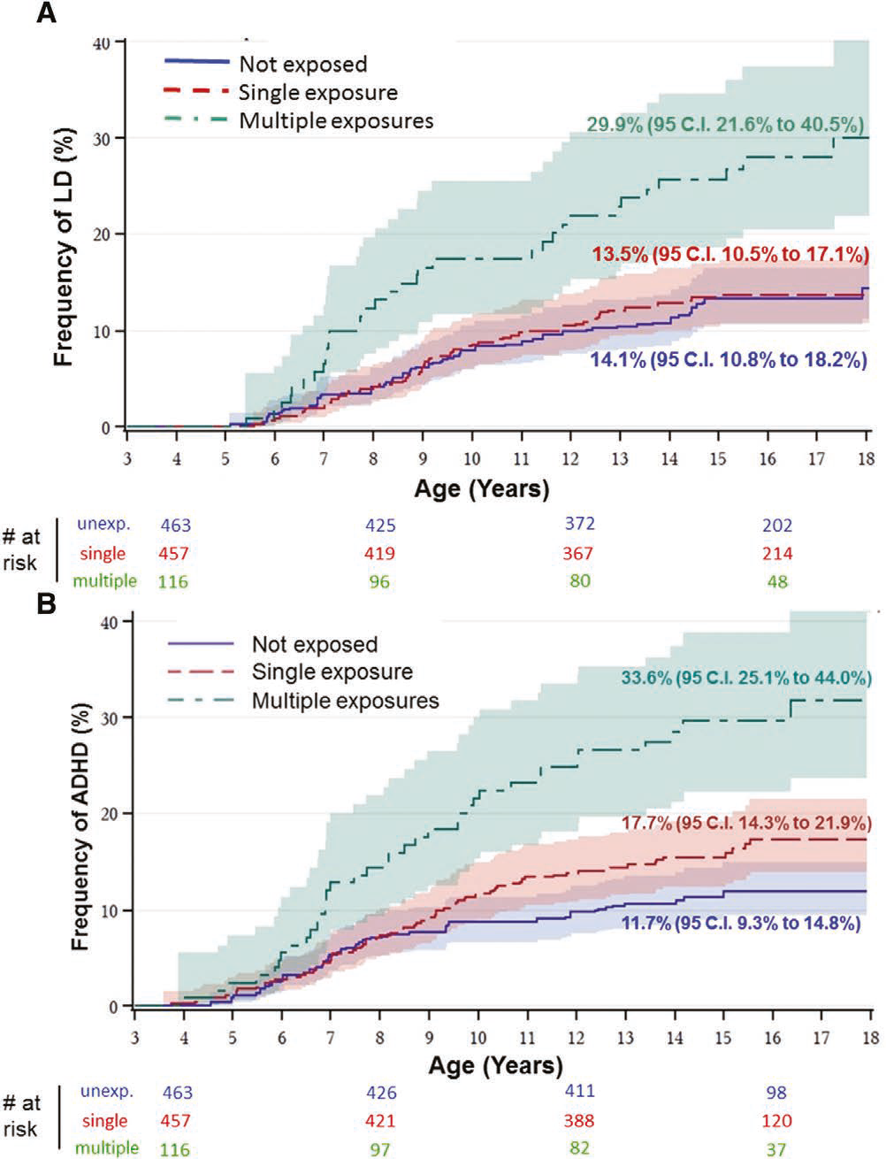
Anesthesiology 2017

Slide 23
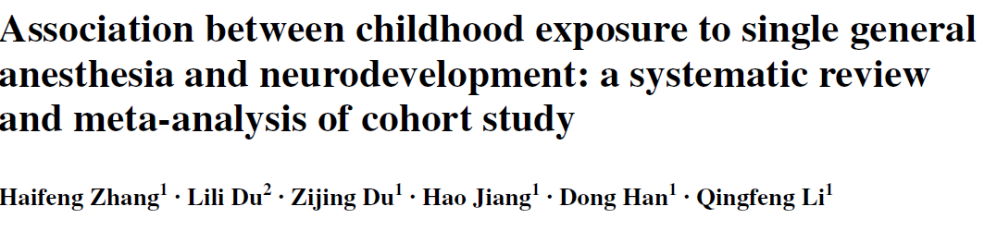
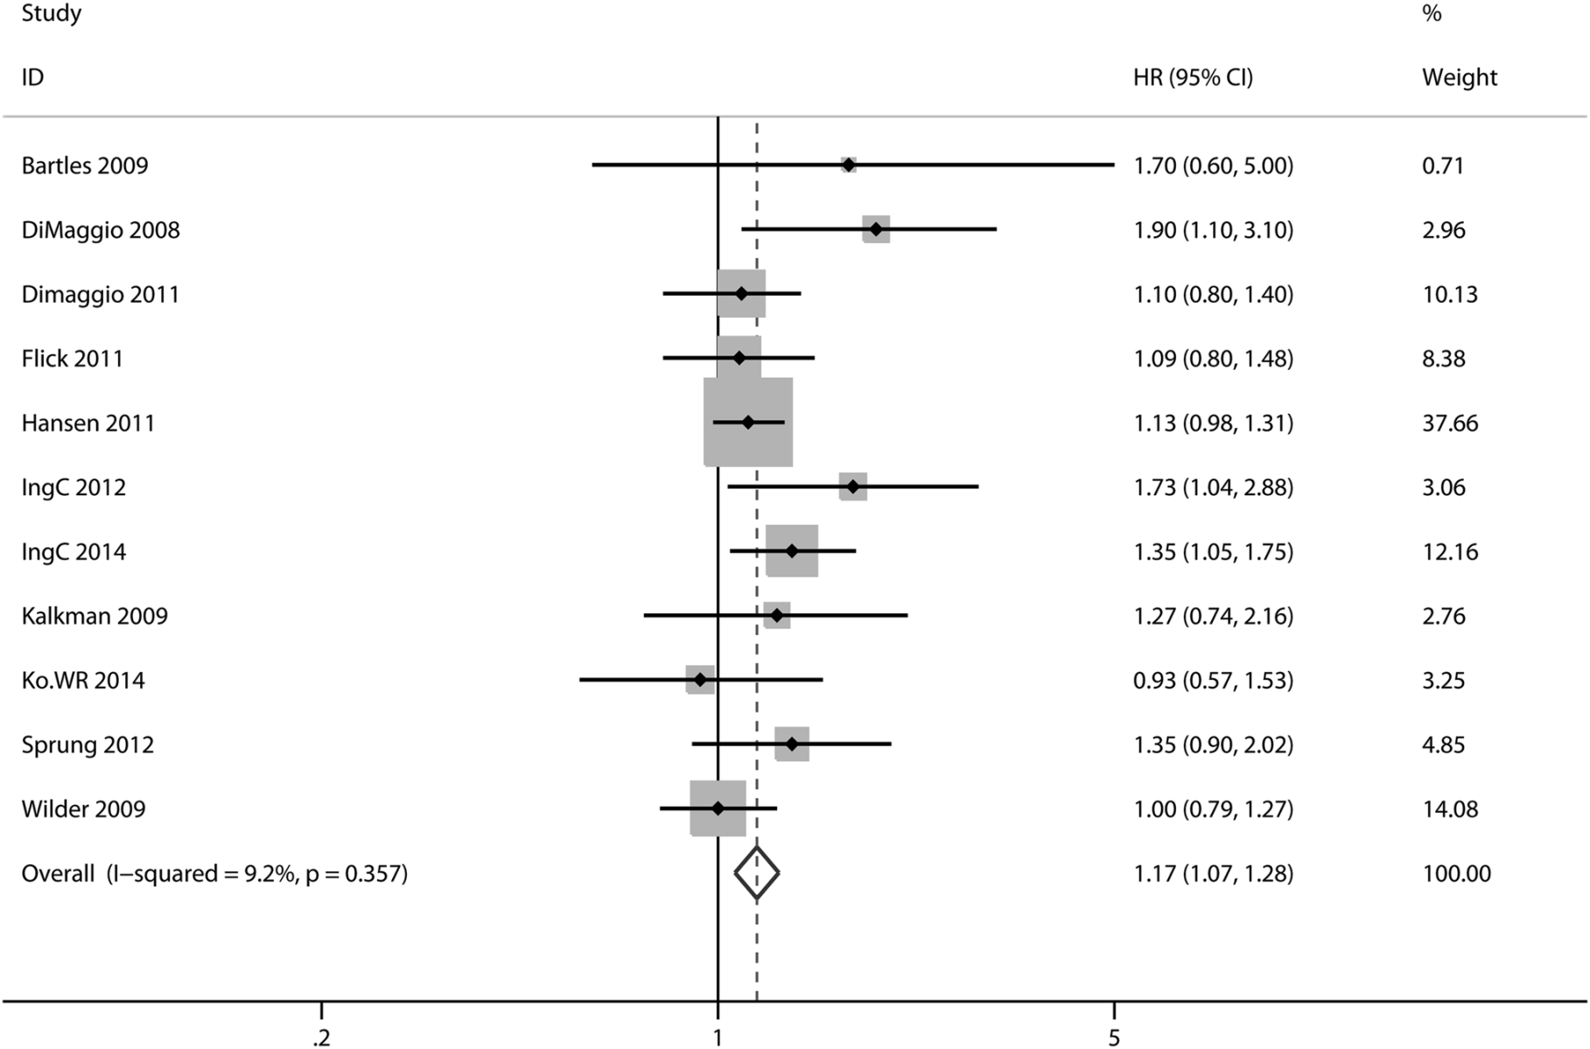
J Anesth 2015
exposure
Notes:
Forest plot showing the association of single general anesthesia with the risk of neurodevelopment before age 4 in 11 studies after omitting
Bong et al. [8] and DiMaggio et al. [16]

Slide 24

More recent cohort studies
Control confounders
Region & nation wide cohorts
Linking
  Hospital data
  Insurance companies
  School performance
  …

Slide 25
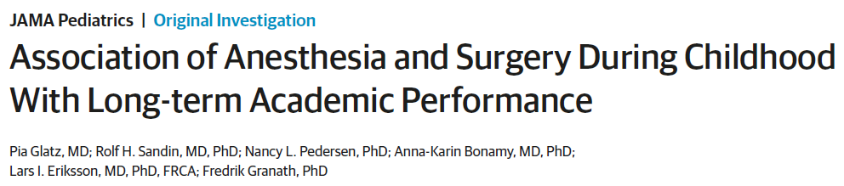
JAMA Ped 2016
Nationwide cohort study among all children born in Sweden between January 1973 and December 1993
  n= 159 619
Anesthesia and surgery before age 4 years:
  n= 33 514
Academic and cognitive performance indexed by school grades at age 16 years and IQ test scores at military conscription

Slide 26
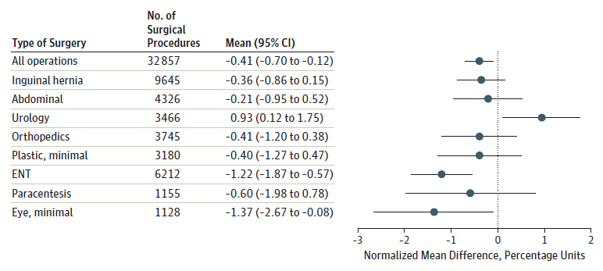
JAMA Ped 2016
School performance:

Slide 27
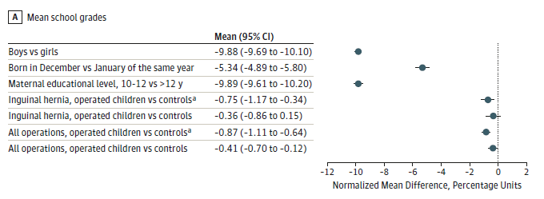
JAMA Ped 2016
School performance: relation non-surgical variables
Conclusion:
Exposure to anesthesia < 4 is associated with small difference in academic performance or cognitive performance
“The magnitude of this association should be interpreted in light of potential adverse effects of postponing surgery”

Slide 28
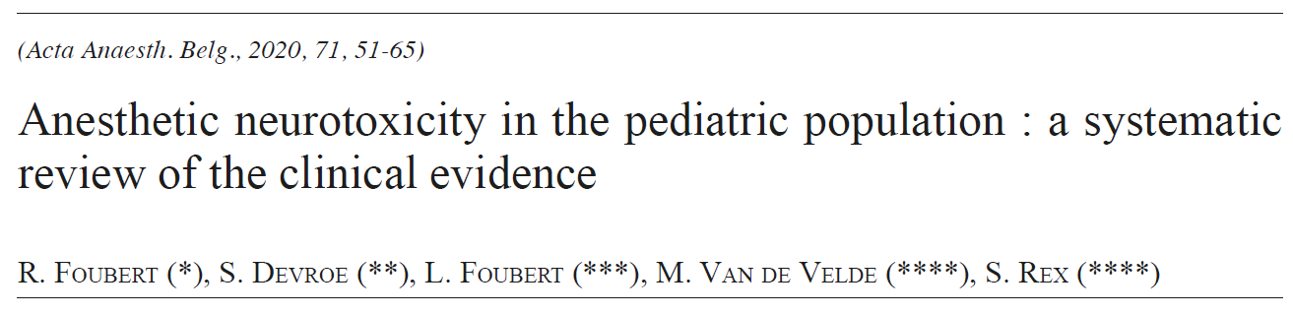
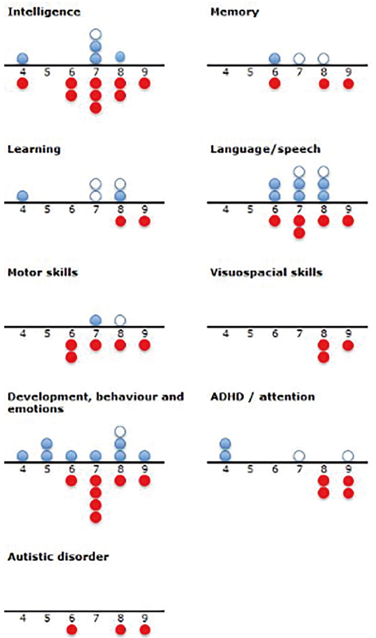
Evidence association:
Single & multiple
Multiple only
No
Notes:
Fig. 4. — Graphical representation of the results for each neurodevelopmental domain. The X-axis represents the risk of bias assessment based on the 9-Star Newcastle- Ottawa Scale for assessing the risk of bias in observational studies. A higher number indicates a lower risk of bias. For the purpose of this graphic, the RCT by McCann (29) is attributed the highest score of 9 because it is a RCT with a low risk of bias according to the Cochrane Tool. A full blue circle represents a study that showed an association between exposure to GA and a neurodevelopmental deficit (both in singly and multiply exposed children or in a study that made no distinction between the two). An open blue circle represents a study that only showed an association in multiply, but not in singly exposed children. A full red circle represents a study that showed no association (either in both singly and multiply exposed children or in a study that made no distinction between the two).

Slide 29
Is anesthesia dangerous for the brain?
Is the perioperative period dangerous for the brain?
Potential contributing factors
surgery?
anesthesia management?
drugs?
inflammatory
cascades
blood pressure
neurotransmission
O2 & CO2
neural activity
sugar & electrolytes
and/or
neuroinflammation
direct toxicity
temperature
physical / functional lesion of nervous tissue

Slide 30
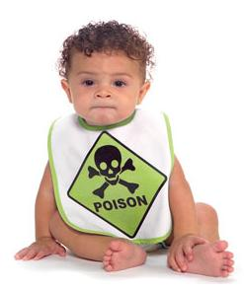
Anesthesia neurotoxicity?
>1000 publications experimental studies
Rodents and non-human primates
(Almost) all anesthetic drugs
Dose and duration dependent
Window vulnerability
Period?
  Younger age
  <2-3 year?
Clinical proof:
  Cohort studies: Confounding!
  Randomized Clinical Trial

Slide 31
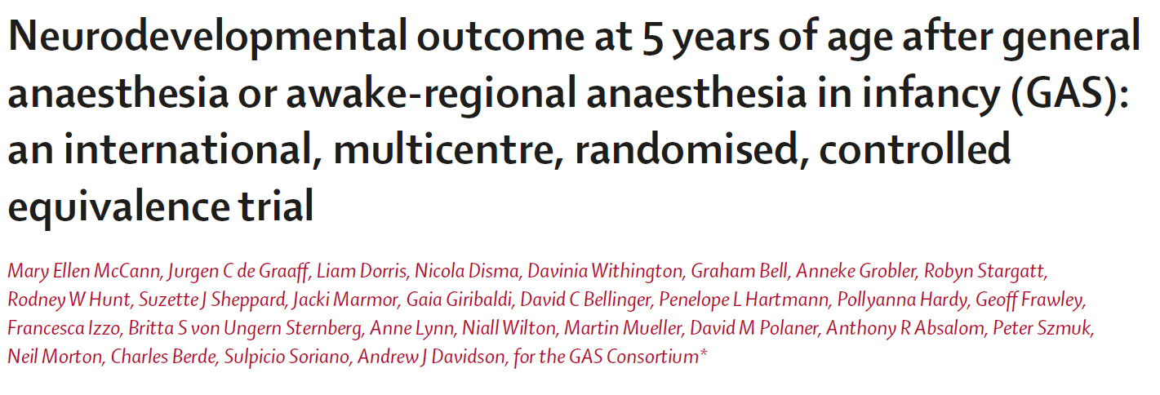

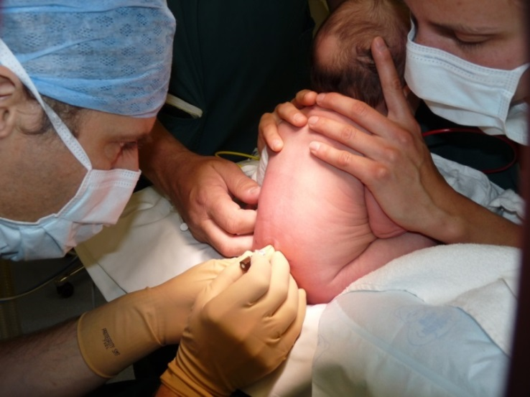
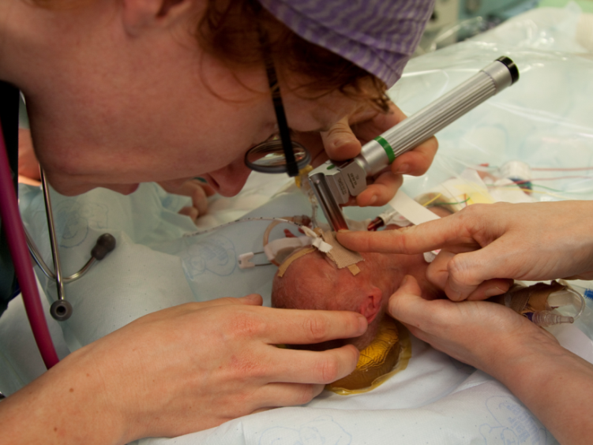
Inguinal hernia repair (< 60 post conceptional age = 4 month): n=722
Randomized, assessor blinded, multisite equivalence trial
Neuropsychological development 5 yrs: WPPSI-III Full Scale IQ score

Slide 32
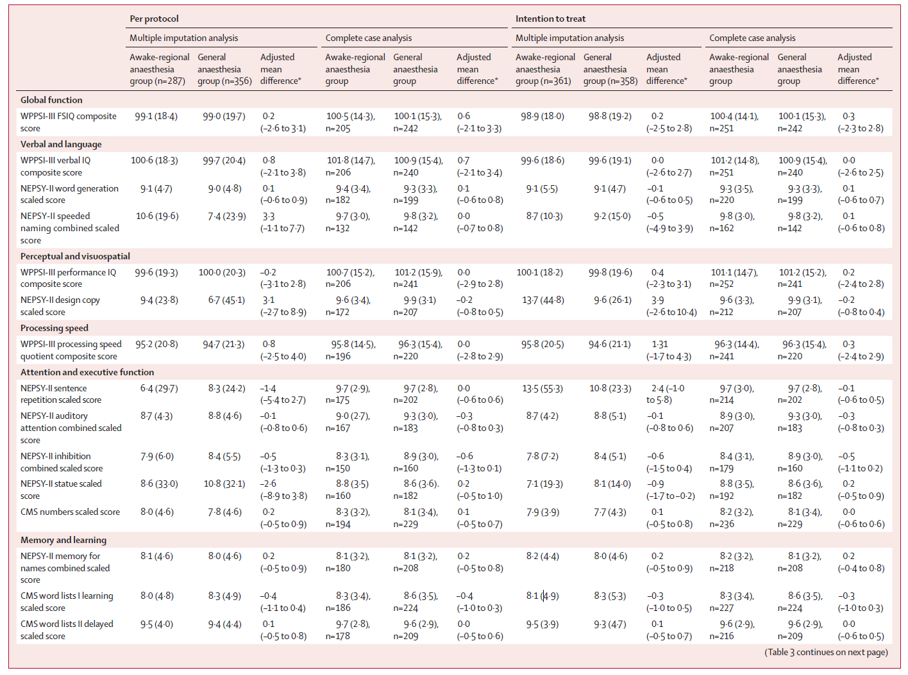
Results: Strong evidence for equivalence

Slide 33
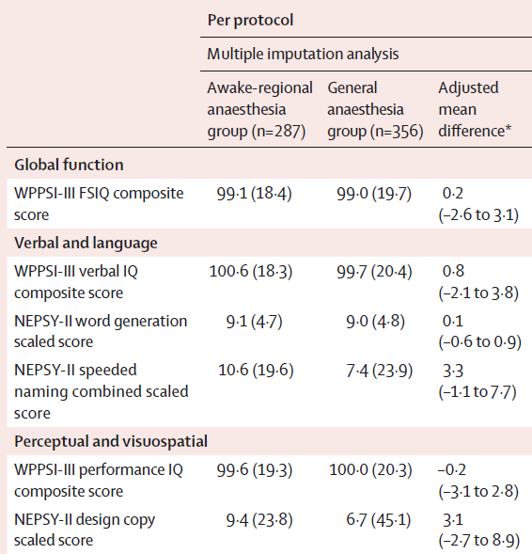
Results: Strong evidence for equivalence

Slide 34
Summary GAS-study 5YR
Strong evidence that an hour of exposure to a general anesthetic during early infancy does not cause measureable neurocognitive or behavioral deficits at 5 years of age.
Limitations:
  No information about multiple-prolonged anesthesia (>1h)
  Predominantly male population
  No measure of higher executive function!

Slide 35
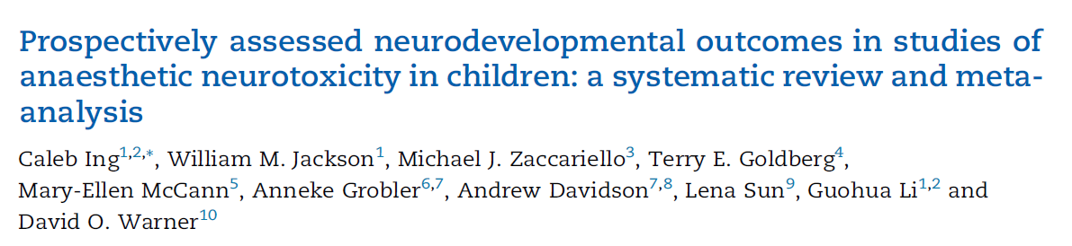
British Journal of Anaesthesia, 126 (2): 433e444 (2021)
Notes:
single GA exposure
was associated with statistically significant increases in parent reports of behavioural problems with no difference in
general intelligence.

Slide 36
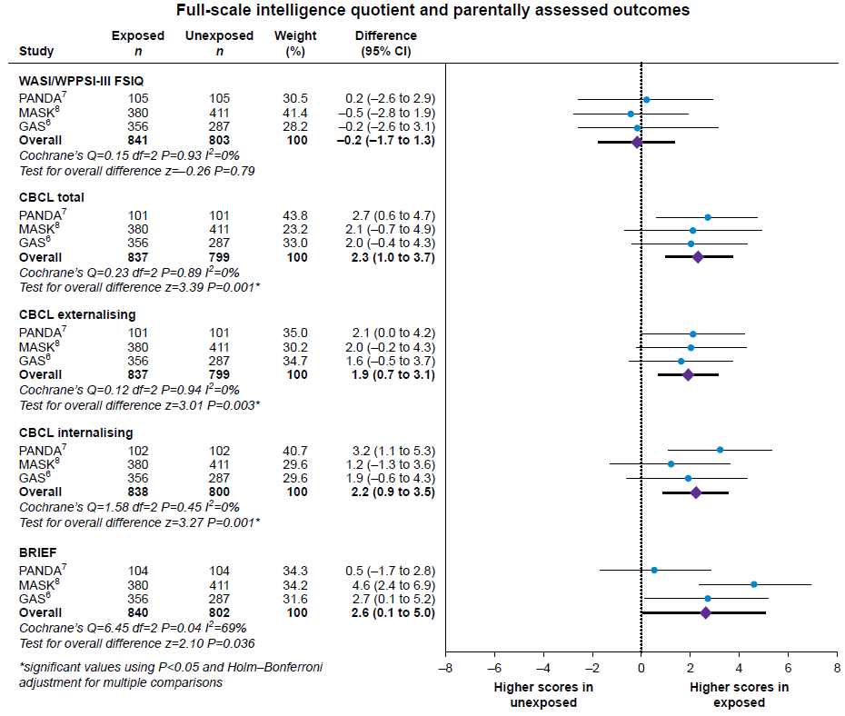
General intelligence
Behavioural problems
British Journal of Anaesthesia, 126 (2): 433e444 (2021)

Slide 37
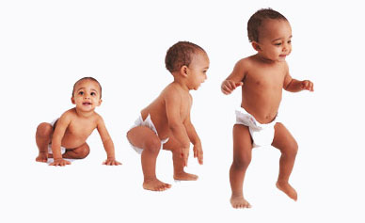
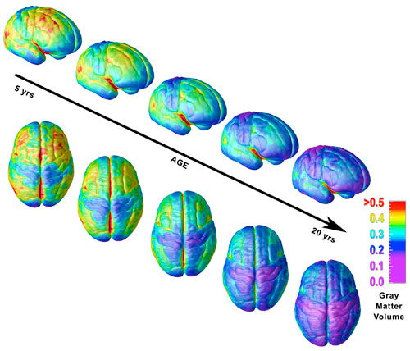

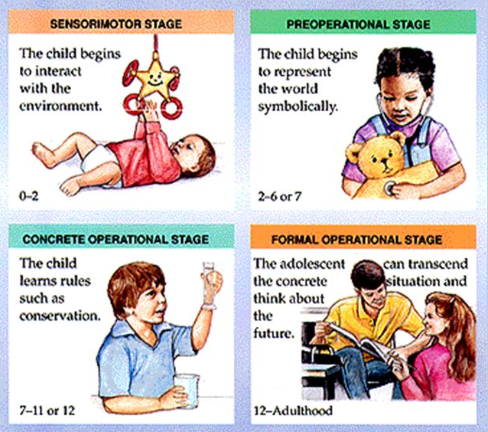
Follow-up
Children
Notes:
http://harvardmagazine.com/2008/09/the-teen-brain.html

Slide 38
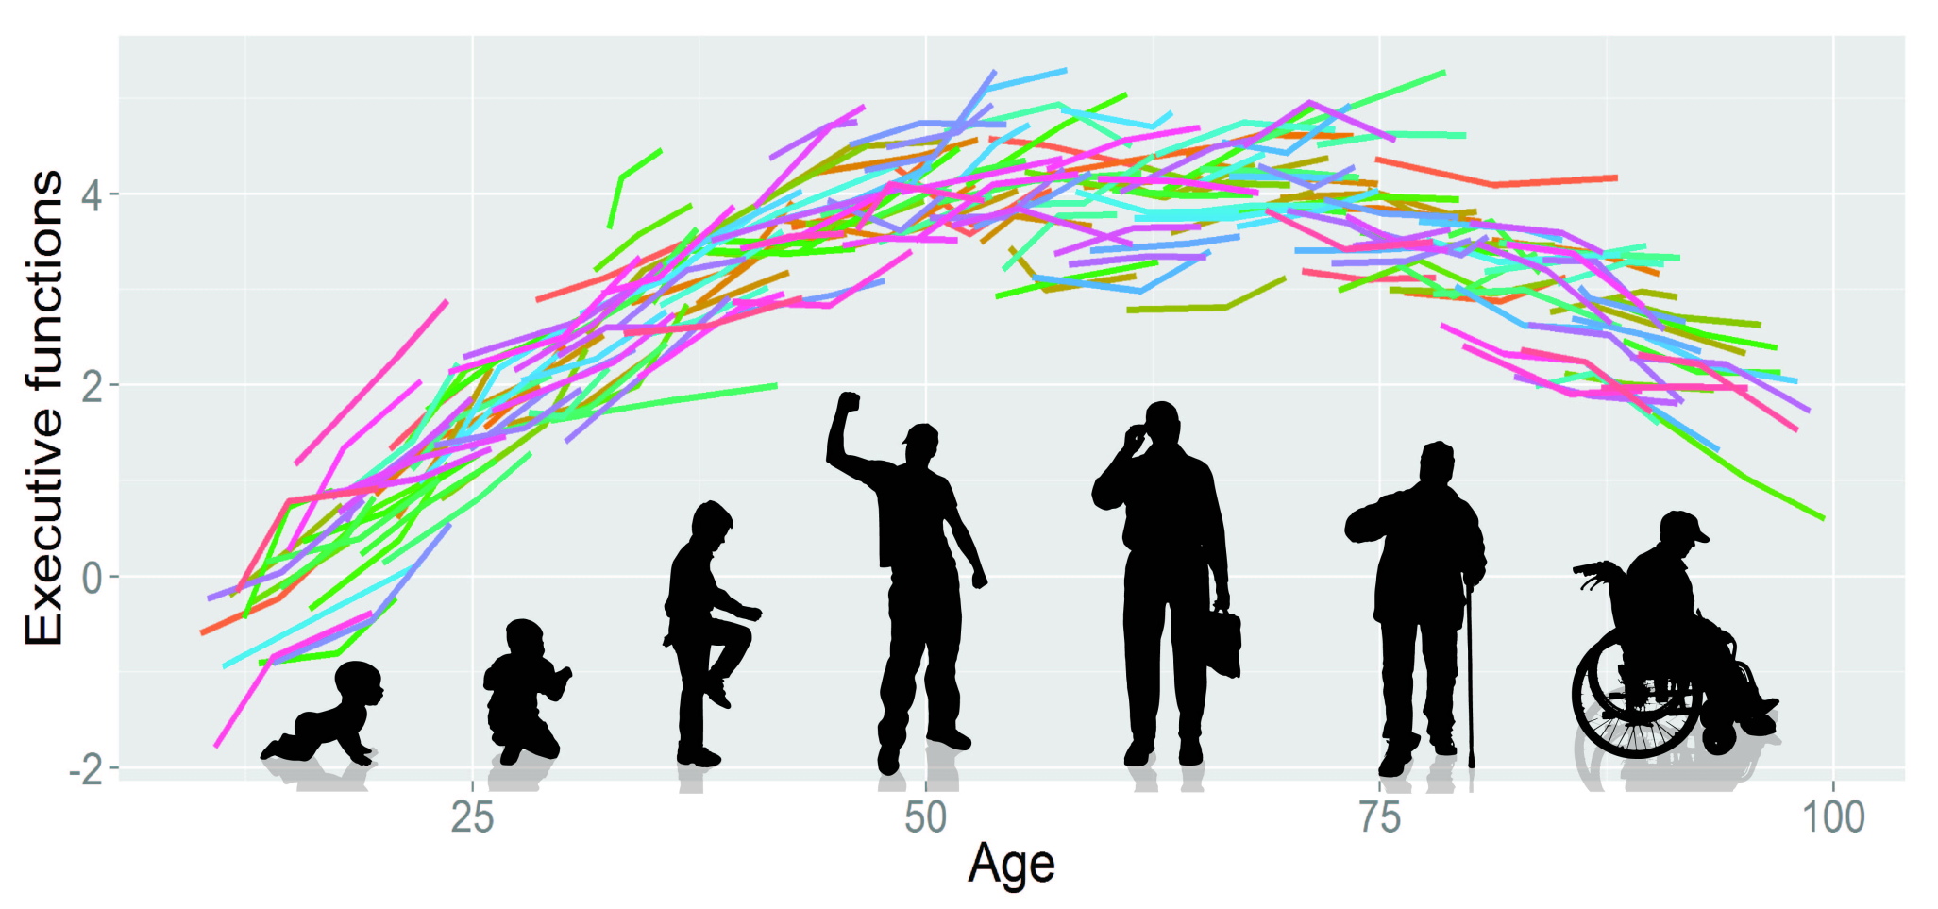
Long term follow-up: Growing into deficit!
The Rise And Fall Of Executive Functions: Modelling neurodevelopmental changes in higher cognitive abilities.
Notes:
http://www.mrc-cbu.cam.ac.uk/our-research/kievit/

Slide 39
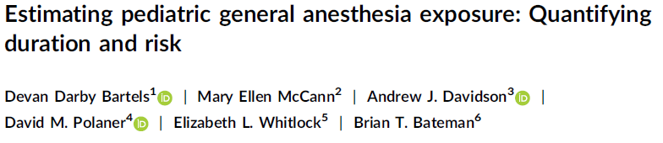
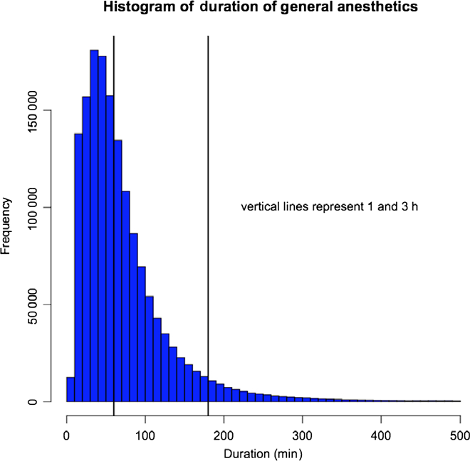
Pediatric anesthesia 2018: 1-8

Slide 40



FDA warning: 14 Dec 2016
“The U.S. Food and Drug Administration (FDA) is warning that repeated or lengthy (>3h) use of general anesthetic and sedation drugs during surgeries or procedures in children younger than 3 years or in pregnant women during their third trimester may affect the development of children’s brains.”

Slide 41

Europe

Slide 42

Europe statement
ESA, ESPA
No child should ever undergo any medical procedure that is not necessary.
However, delaying or avoiding surgery may result in a significant and real risk of a variety of adverse outcomes.
If an invasive procedure is necessary, adequate anaesthesia/analgesia are mandatory.
There is currently no compelling evidence to change anaesthetic practice.
Hansen European Journal of Anaesthesiology 2017, 34:327–328

Slide 43



Anesthesiology; 2019

Slide 44



Anesthesiology; 2017: 128:697-9

Slide 45



Slide 46

TREX-study
Primary objective to determine
low-dose sevoflurane/dexmedetomidine/remifentanil anaesthesia
is superior to standard dose sevoflurane anaesthesia
Anesthesia > 2 ½h
in terms of the global cognitive function as assessed by the full scale IQ score at 3 years of age.
Inclusion still going!
Pediatric Anesthesia 2019

Slide 47
Safety of Procedural Sedatives in young children:
Is neurotoxicity an issue?
Stress is harmful
Low dose anesthetics!
Short procedures
Combine procedures
Opiates are not toxic
Comfort!

Slide 48





































































Thank you for your attention! www.pediatric-anesthesia.eu
J.degraaff@erasmusmc.nl

Slide 49


