Slide 1
Risk Factors and Adverse Events in Pediatric Procedural Sedation
PROSA2022
2nd European Conference on Pediatric Procedural Sedation And Analgesia
September 9, 2022
Maala Bhatt MD, MSc., FRCPC
Associate Professor of Pediatrics Director of Emergency Research Children’s Hospital of Eastern Ontario University of Ottawa (Canada)

Slide 2
Disclosure Information
I will be discussing sedation drugs, some of which are not FDA or Health Canada approved for children
I do not have any financial relationships to disclose

Slide 3
SAFE

Slide 4
ROUTINE

Slide 5
STANDARD OF CARE

Slide 6
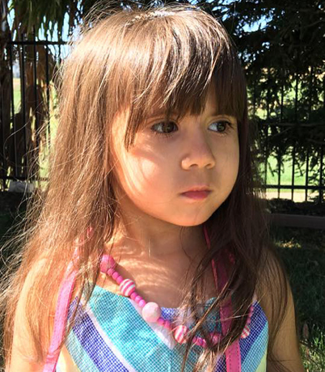
Marvelena Rady
Notes:
3 year old girl, healthy
Dental restoration
Complications from anesthesia

Slide 7
Daisy-Lynn
Torres
Notes:
14month old Texas
Dental work

Slide 8
Ly Tri
Dung
Notes:
4 year old boy healthy
Sedation for a dental procedure
Died from complications

Slide 9
Finlay
Boyle
Notes:
3 year old girl from Hawaii
Sedation for dental procedure
Medicaitons administered by the receptionist
Healthy, did have a cold in the week prior to her sedation
Complications from sedation

Slide 10
Caleb
Sears
Notes:
6 year old healthy boy from California who is described by his family as a light of life
He underwent an elective procedure at an oral surgeon’s office to extract a supernumery tooth
Caleb had his surgery in a private office – present for the procedure was an oral surgeon and 2 dental assistants
Caleb received midazolam, fentanyl, propofol and ketamine intravenously – administered by the surgeon
No one noticed that Caleb had stopped breathing until the sat monitor alarmed and read 69%
The rescue efforts were woefully inadequate – no one performed CPR, no one attempted to insert an oral or nasal airway and no reversal drugs were administered. He was without oxygen for at least 20 minutes before paramedics arrived. They achieved ROSC in the ED but Caleb Sears passed away 2 days later.

Slide 11
Serious adverse events in procedural sedation outside of the operating room are LOW
Events with the potential to harm and that require timely rescue interventions are COMMON

Slide 12
Objectives
Understand patient, procedure and medication risk factors for sedation-related adverse events
Become aware of mitigation strategies to assess and prepare for risk factors
Review sedation practices associated with the best outcomes

Slide 13
Airway
> 95% problems
happen here
Breathing
Circulation
Detonate
< 5% happen here
(vomiting)
Everything Else
Notes:
Since 95% of all events in sedation occur with the airway or breathing, this is where we are going to focus the discussion on risk factors

Slide 14
Airway
Airway obstruction
Oxygen desaturation
Apnea
Laryngospasm
Breathing
Circulation
Detonate
Everything Else

Slide 15
PATIENT CHARACTERISTICS the pre-sedation assessment

Slide 16
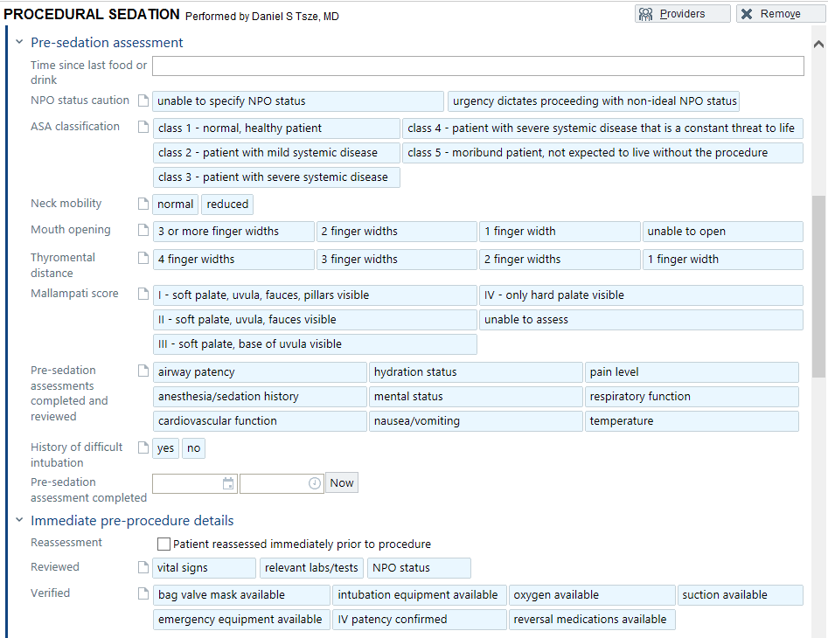
Notes:
Does my patient have any features that could lead to airway or breathing complications
Does my patient have any features that predispose them to pulmonary aspiration?
Does my patient have any major medical illnesses that will put them at higher risk when sedated?
The problem is that our pre-sedation documentation does not actually help move us closer to understanding risk in a meaningful way. I got Dan to send me some screenshots of your pre-sedation documentation to see where things were at in your institution. And I have to say that it looks a lot like the documentation in most other places, my hospital included. First of all, it is quite limited and focuses on aspects that has been handed down from the old days when anesthesia was in charge of all sedations such as last oral intake and assessment of the ease of intubation.
And I get why this happens - our documentation in electronic medical records is often standardized across institutions and sometimes across many institutions in the same hospital network so ultimately is not able to really reflect a risk specific to a population. In the past decade there has been a lot of work on risk factors in pediatric patients undergoing sedation that are not reflected in our pre-sedation documentation. As such, I don’t think we are consistently asking questions that will help inform us of patient risk and that would allow us to employ mitigation strategies. What I’d like to do for the next 40 minutes or so is to provide you with the science behind risk factors – those we don’t ask about and those that we do – and ultimately, it’s my hope that someone out there will take on the challenge to start the conversation at your institution to move towards a more evidence-based and relevant pre-sedation assessment of risk. A lot of the work I’m going to present to you today comes from the Pediatric Sedation Research Consortium, an organization with which I imagine you are all familiar. The PSRC has really driven the research landscape forward in pediatric sedation and much of what we know has come from them. Many of the studies I am going to present to you are not ED-specific, but I’ve chosen settings and risk factors that I think are still relevant to us.

Slide 17
Notes:
But what about a kid like this? An open mouth breather who snores?

Slide 18
Srinivasan Pediatrics 2012
Retrospective chart review
1649 propofol sedations for diagnostic imaging
Sedations performed by hospitalists
Risk factors for airway adverse events
Snoring or OSA + Airway AE
OR 2.4
(95%CI 1.5 to 3.8)
Notes:
In 2012 Srinivasan and colleagues performed a retrospective chart review of 1649 propofol sedations for diagnostic imaging procedures. All of the sedations were performed by hospitalists and they looked to see what factors were associated with adverse events. What they found was that patients with snoring or OSA had 2.4 times the odds of experiencing an airway adverse event. And 2.7 times the odds of requiring an airway intervention.

Slide 19
Srinivasan Pediatrics 2012
Retrospective chart review
1649 propofol sedations for diagnostic imaging
Sedations performed by hospitalists
Risk factors for airway adverse events
Snoring or OSA + Airway intervention
OR 2.7
(95%CI 1.9 to 3.9)

Slide 20
Grunwell PEC 2014
Retrospective chart review
804 sedations by multi-specialty providers
Diagnostic imaging and brief procedures
Risk factors for failed sedations
Snoring or OSA
OR 2.1
(95%CI 1.2 to 3.5)
Notes:
Similarly, in 2014 Jocelyn Grunwell and colleagues performed a retrospective review of 804 sedations at a single centre by a multi-specialty providers. Most of these sedations were for diagnostic imaging and brief procedures such as LPs auditory brain stem response tests, PICC line insertions and renal biopsies. The objective of this study was to identify risk factors for failed sedations. A failed sedation was defined as failure to complete the imaging test or procedure as a result of an adverse event or complication. They found a history of snoring or OSA was associated with twice the odds of experiencing a failed sedation.

Slide 21
Beach Anesthesiology 2016
PSRC: multi-centre, multi-year database
139,142 sedations by multi-specialty providers
Risk factors for major complications
Snoring or OSA
OR 5.3
(95%CI 1.1 to 16.1)
Notes:
Finally in 2016 Beach and colleagues from the PSRC reported on almost 140,000 sedations. As you know most of these sedations are performed by sedation services by multi-specialty providers. They looked at risk factors for major complications which were defined as any incidence of pulmonary aspiration, unplanned admission to hospital, cardiac arrest or death. I know, truly MAJOR by any measure ☺. What they found was that snoring or OSA was associated with over 5 times the odds of experiencing a major complication. You can see here that the CI is pretty wide though, so interpret the magnitude of this finding with that in mind.
IN ANY CASE, we have evidence that OSA or snoring is associated with increased odds airway adverse events and interventions, failed sedations and truly major complications.

Slide 22
Notes:
Next, let’s look at our bread and butter kid pre-COVID when there were actually viruses circulating.

Slide 23
Mallory Pediatrics 2017
PSRC: 83,491 sedations
Association between URI and airway AE
URI definition
Runny nose, nasal congestion, sneezing or mild cough without sputum
Symptoms < 2 weeks
Characterized secretions: thin/clear or thick/green
Patients excluded if signs of LRTI (eg. fever)
Notes:
Again from the PSCRC, Mike Mallory and colleagues looked at over 80,000 sedations in their database to see if there was an association between URIs and airway adverse events.
URIs were defined as runny nose, nasal congestion, sneezing or mild cough withough sputum
Symptoms must have been present for less than 2 weeks
They also characterized the secretions as thin and clear or thick or green
Patients were excluded if they showed any signs of lower respiratory involvement such as fever

Slide 24
Mallory Pediatrics 2017
Notes:
As you can see, they split their population into 4 groups. Those who did not have a URI, those with a recent URI, defined as symptoms within the last 2 weeks, those with a current URI but with clear or thin secretions and finally those with a current URI and thick secretions

Slide 25
Mallory Pediatrics 2017
Notes:
Their population was quite young with a median age of around 4 in the “at risk” categories” and it was sicker than our population with 15-20% of kids being ASA 3 or higher.

Slide 26
Notes:
They performed an adjusted analysis, which is important given that the risk factors were not balanced among the 4 different categories. In this figure, we see a modified forrest plot of the 3 risk categories, each depicted by a different colour. Black is a recent URI, grey is for a current uri but thin secretions and green is current uri and thick secretions. If we look at the odds of ANY Airway adverse event occurring, we can see that all three categories of patients are at risk of developing an airway adverse event and the risk increases as we move from a recent URI to current URI with thick secretions. These are very positive OR with tight confidence intervals from just below 2 for kids with recent URIs to around 4 for those who have a current URI and thick secretions.

Slide 27
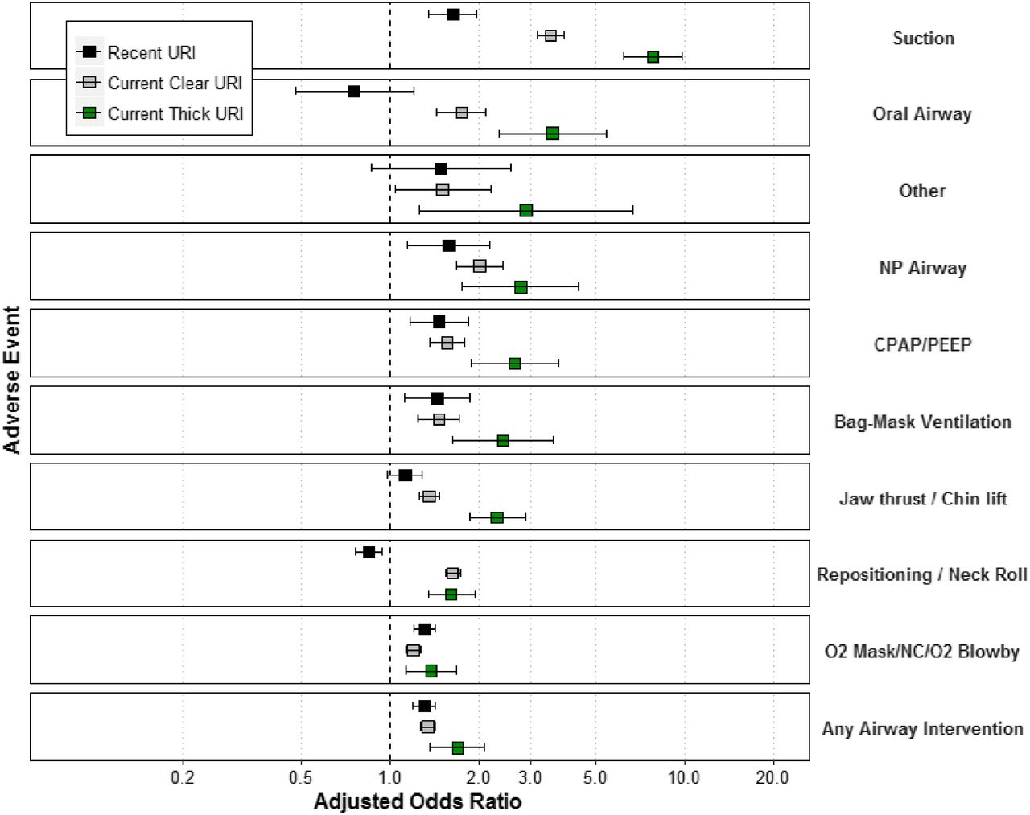
Notes:
This next slide looks at the adjusted analysis for performing interventions. And again all the categories of patients have increased odds of needing an airway intervention.
The presence of URI itself does not preclude a ptient from undergoing a sedation but a risk-benefit analysis regarding the length and urgency of procedure should be undertaken.

Slide 28
Notes:
Looking at obesity, we often consider the challenges associated with bag mask ventilation in this population but we also need to incorporate our knowledge that obese patients can rapidly desaturation and that they have increased sensitivity to the respiratory depressant effects of medications.

Slide 29
Scherrer Pediatr Anesth 2015
PSRC: 28,792 sedations
18% (n=5153) obese
Association between obesity and AE
Obesity: > 95th percentile
Airway Obstruction
OR 1.9
(95%CI 1.5 to 2.4)
Notes:
In 2015 Scherrer and colleagues reported on 28000 sedations from the PSRC with the goal of understanding the impact of obesity on sedation related outcomes.
In this study, 5000 kids or close to 20% of the cohort met their definition of obesity which was BMI > 95th percentile for age and gender. And what they found was obese patients
Had nearly twice the odds of experiencing an airway obstruction
They had twice the odds of experiencing an oxygen desaturation
And almost twice the odds of requiring unexpected PPV

Slide 30
Scherrer Pediatr Anesth 2015
PSRC: 28,792 sedations
18% (n=5153) obese
Association between obesity and AE
Obesity: > 95th percentile
Oxygen desaturation
OR 2.0
(95%CI 1.5 to 2.6)

Slide 31
Scherrer Pediatr Anesth 2015
PSRC: 28,792 sedations
18% (n=5153) obese
Association between obesity and AE
Obesity: > 95th percentile
Unexpected PPV
OR 1.8
(95%CI 1.3 to 2.3)
Notes:
Rapid desaturation, increased sensitivity to respiratory depressant effects of sedatives, challenges with BVM

Slide 32
Scherrer Pediatr Anesth 2015
Notes:
In addition, the odds of not being able to complete the procedure, experiencing a laryngospasm and having a prolonged recovery were also approximately twice that of the non-obese kids.
Another study by Hirsch and colleagues in 2017 looked at > 800 ED sedations and found similar results. Some people have hypothesized that the over-estimation of medication needs in these children may explain the higher rate of events.

Slide 34
Premature Infants
< 50 weeks corrected GA at risk for apnea hours after the sedation event
Notes:
Anesthesia studies have shown infants < 50 weeks corrected GA have a higher risk of apnea several hours after the sedation/anesthetic event and therefore should be admitted overnight for observation. There is one large study from the PSRC that

Slide 35
History of Prematurity
685 patients with a history of prematurity
Compared to > 56,000 term infants
Adjusted for age, gender
Any Adverse Event
OR 1.9
(95%CI 1.6 to 2.4)
Havidich JE, Beach M, Dierdorf SF. et al. Pediatrics. 2016

Slide 36
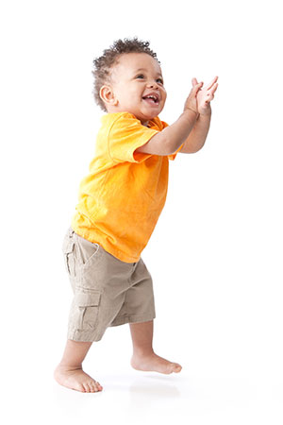
Children 1 month to 1 year
~140,000 sedations
Risk factors for MAJOR COMPLICATIONS
Aspiration
Cardiac arrest, death
Unplanned admission
OR 3.0
(95%CI 1.5 to 6.5)
Beach et al. Anesthesiology. 2016
Notes:
Finally in 2016 Beach and colleagues from the PSRC reported on almost 140,000 sedations. As you know most of these sedations are performed by sedation services by multi-specialty providers. They looked at risk factors for major complications which were defined as any incidence of pulmonary aspiration, unplanned admission to hospital, cardiac arrest or death. I know, truly MAJOR by any measure ☺. What they found was that snoring or OSA was associated with over 5 times the odds of experiencing a major complication. You can see here that the CI is pretty wide though, so interpret the magnitude of this finding with that in mind.
IN ANY CASE, we have evidence that OSA or snoring is associated with increased odds airway adverse events and interventions, failed sedations and truly major complications.

Slide 37
Children < 2 yrs: ED sedation
6,295 ED sedations, 946 ≤ 2 years
No difference in ODDS of serious adverse events, significant interventions or oxygen desaturation
Schlegelmilch et al. Acad Emerg Med. 2021
Notes:
90% of the young patients were between 13 and 24 months, so very few in the under 1 year old category

Slide 38
Special Populations
Autism spectrum disorder
Cerebral palsy
Genetic/Metabolic disorders
Significant underlying health problems
ASA ≥ III
Notes:
Special populations, particularly children with autism have

Slide 39
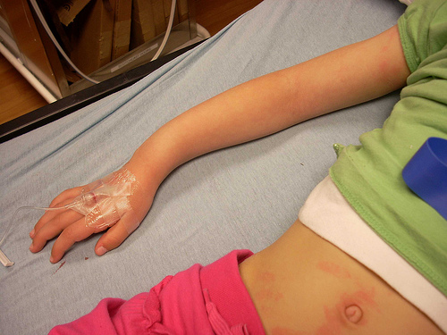
Pre-procedure opioids
Notes:
This next point is very relevant to us in the ED. In kids who have painful injuries, opioids are often given prior to splinting and imaging. In our Canadian sedation study of adverse events we found that there was a strong positive association between preprocedural opioids and the occurrence of vomiting and oxygen desaturation, so we decided to look a little deeper to understand whether the risk changed according to the timing of administration.

Slide 40
Bhatt Acad Emerg Med 2019
PERC: 6,295 ED sedations
1806 received an opioid prior to sedation
Hydromorphone (n=8)
Fentanyl (n=523)
Morphine (n=1255)
Association between timing of opioid administration and adverse events
Notes:
In this parent study we enrolled just over 6000 kids and of these kids, approx. 1800 received an opioid prior to their sedaiton. As you can see, morphine was the most frequently administered opioid and I think this reflects the years of study enrolment vs current practice where at least in our practice environment fentanyl has become the most common. As I said, in this specific study, we looked to see whether there was an association between the timing of opioid administration and adverse events.

Slide 41
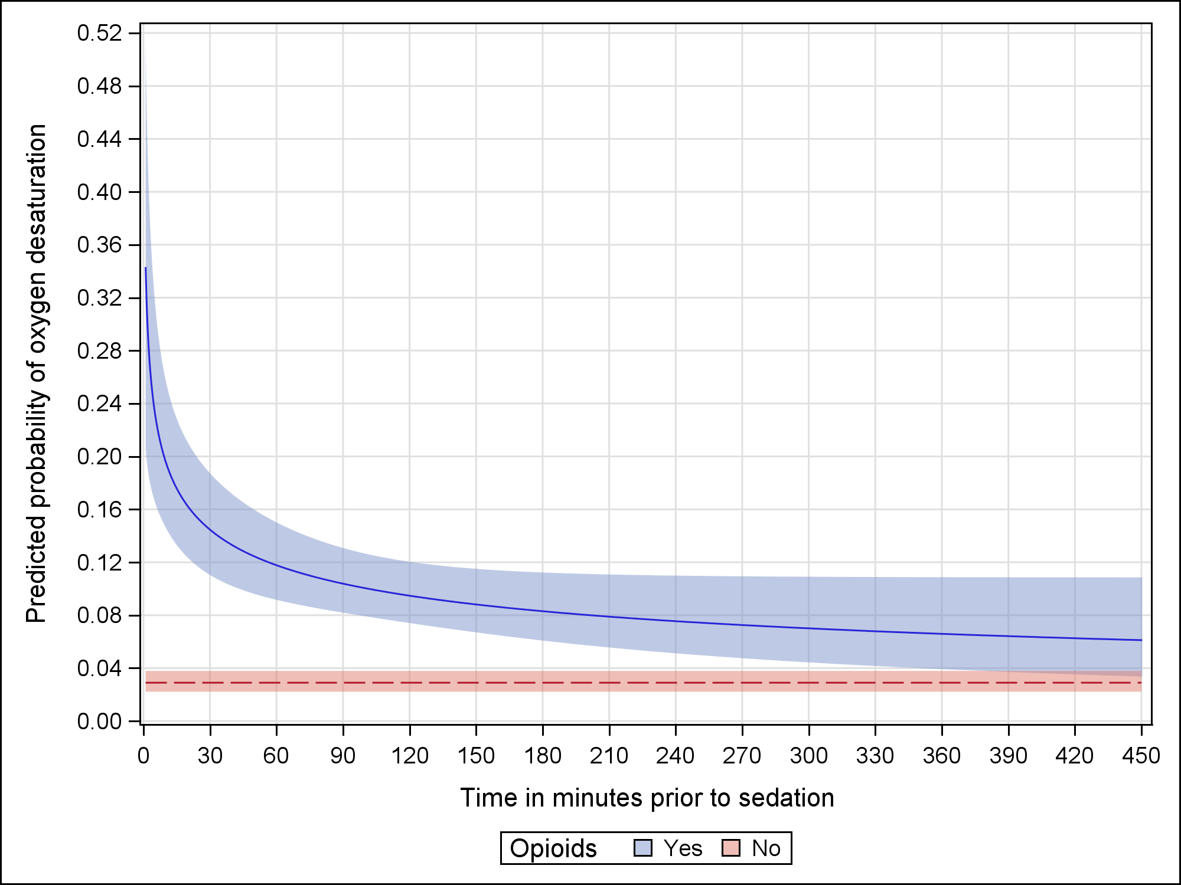
Oxygen Desaturation
Notes:
The next series of slides show the results from adjusted probability modelling, which essentially depict the probability of the adverse event occurring at any given time point. On the xaxis we have the number of minutes prior to sedation that the opioid was administered and on the y axis we have the probability of the occurrence of oxygen desaturation. The solid blue line represents the point estimate of the probability of oxygen desaturation occurring when opioids are given 0 to 450 minutes prior to sedation. The dashed red line represents the probability of oxygen desaturation occurring in patients who did not receive opioids. The shaded area around both lines represent the 95% CIs.
And what we see is that the closer opioids are administered to the time of the sedation, the higher the probability of oxygen desaturation What I find interesting about this is that the risk does not return to baseline for hours. Out here at about 6 hours is when the 2 lines cross. I’m not sure how much weight we can place on this, but it is something to be aware of.

Slide 42
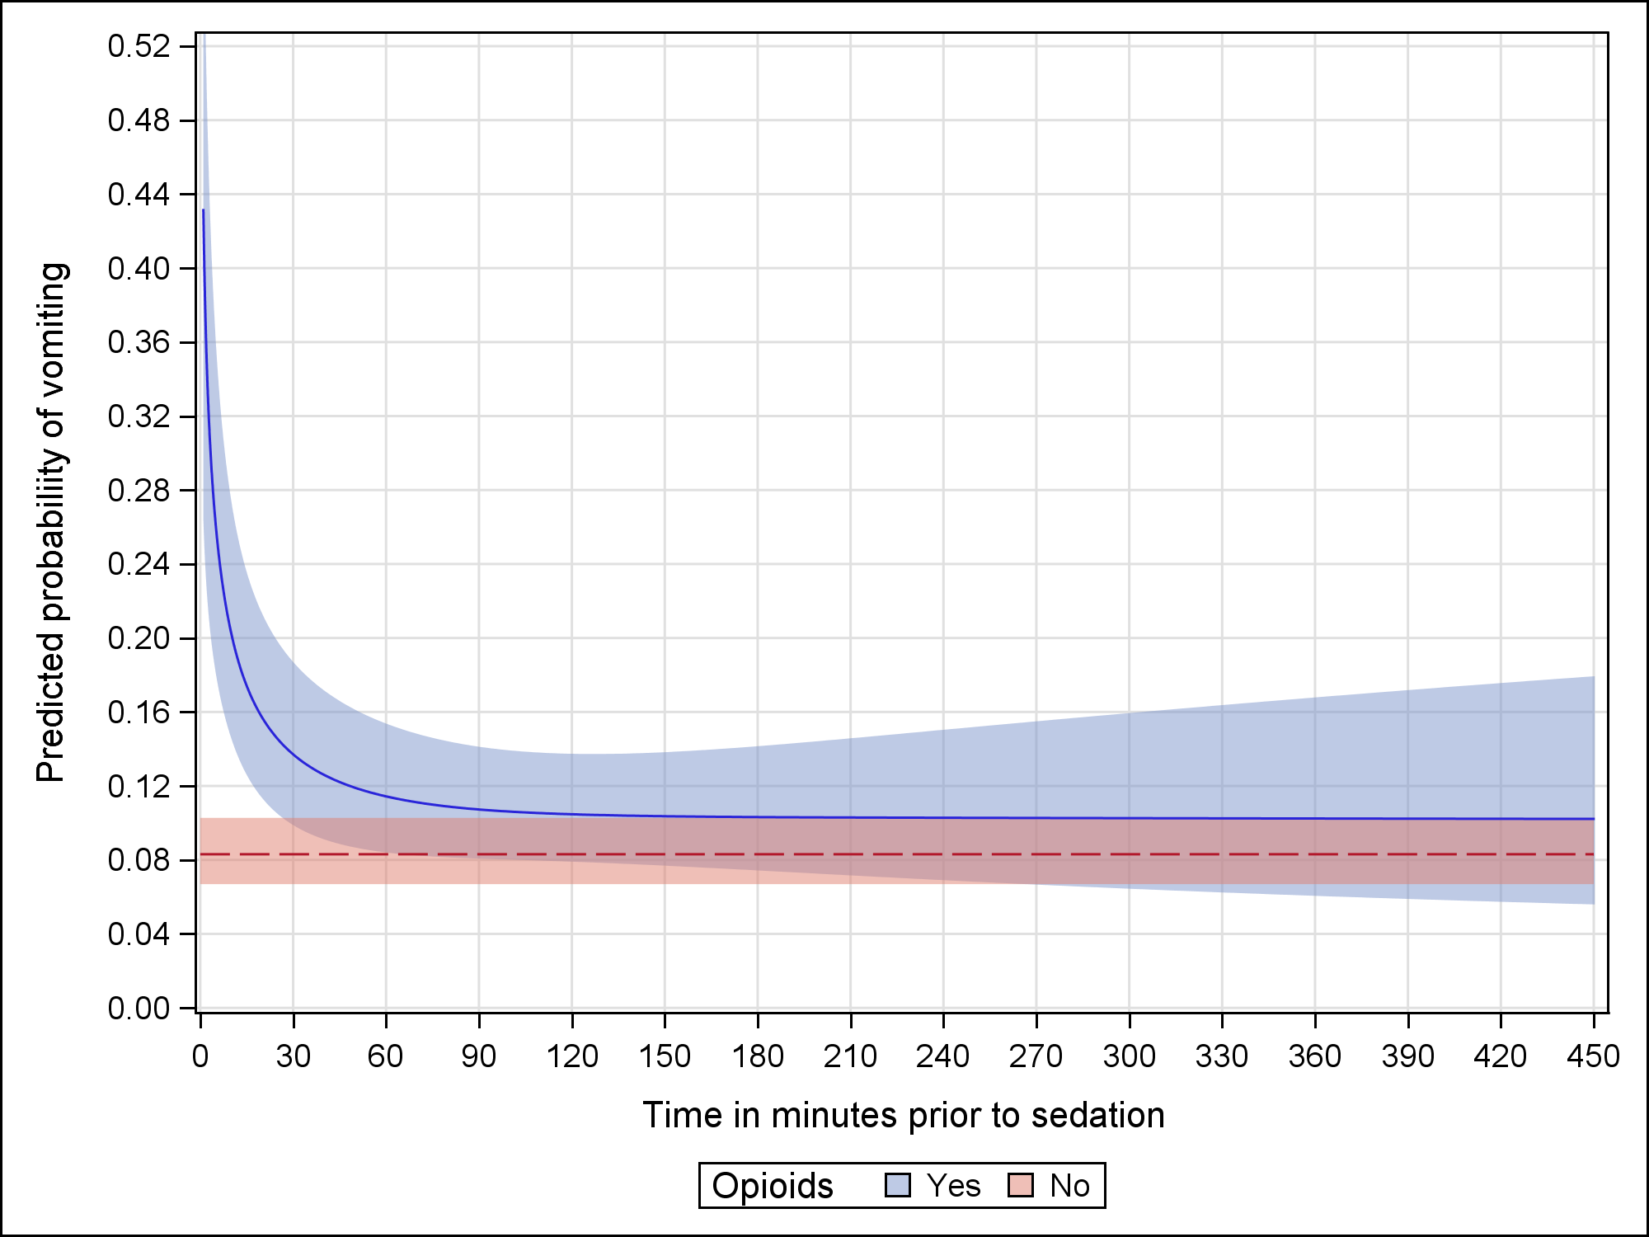
Vomiting

Slide 43
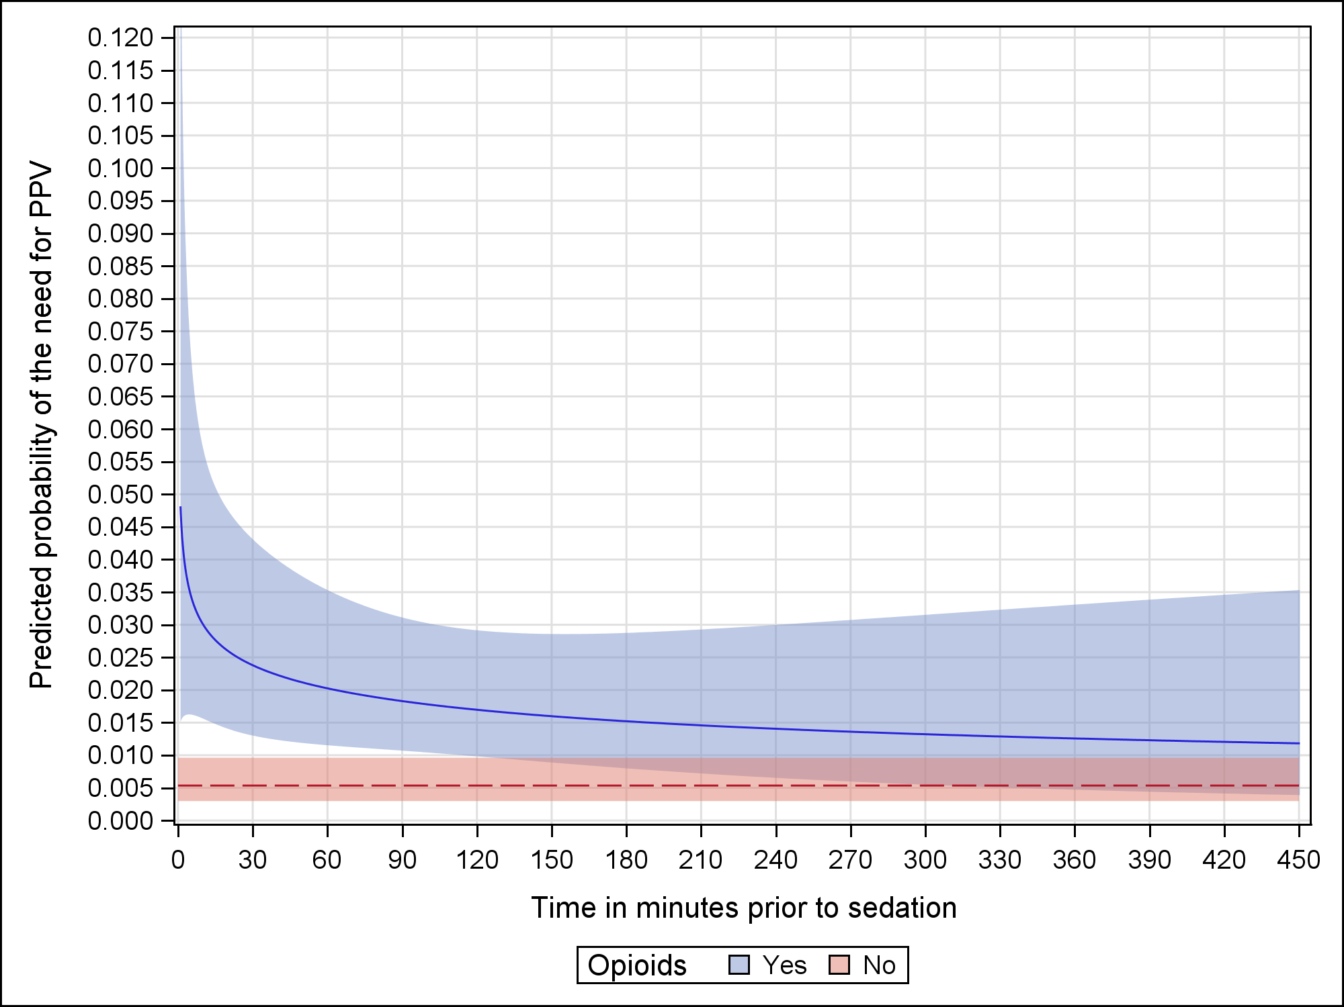
Positive Pressure Ventilation

Slide 44
Targeted Risk Assessment
History of snoring or OSA
Current or recent URI
Active asthma requiring meds?
BMI
Very young age
ASA class III or higher
Pre-procedural opioids

Slide 45
PROCEDURE CHARACTERISTICS

Slide 46
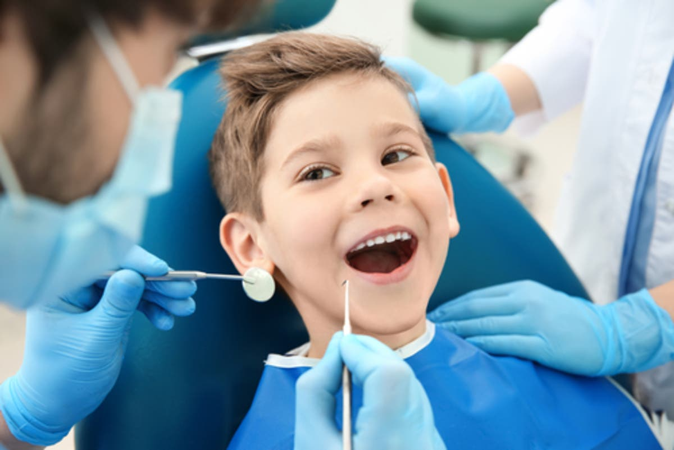
Dental Procedures
Close to the airway, increased secretions
Loose foreign bodies
Risk increased due to number of medications and monitoring practices
Notes:
Depending on the procedure some dental procedures are higher risk because they are close to the airway and can produce a lot of secretions; they also have the added complexity of generating pieces of teeth and tissue that could fall into the airway. There is not a lot of evidence around specific risks for dental sedations, but extra caution is warranted. And some of the risk related to dental sedations can be attributed to the number of medications administered and monitoring practices.

Slide 47
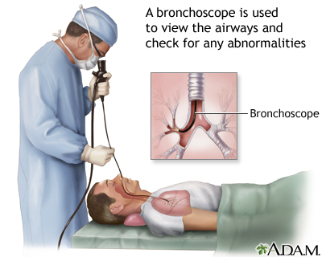
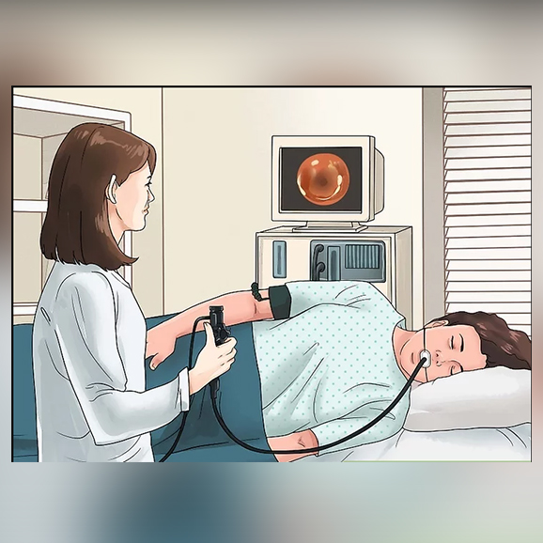
BRONCHOSCOPY
OR 9.4
(95%CI 3.3 to 21.5)
ENDOSCOPY
OR 2.6
(95%CI 1.4 to 4.6)

Slide 48
MEDICATIONS

Slide 49
Cote Pediatrics 2000
Critical incident review
Food and Drug Administration’s adverse drug event reporting system
US Pharmacopeia
Survey of pediatric specialists
Above recommended dosing of medications
Three or more medications used for sedation
Notes:
Critical incident review using US Food and Drug Administration’s adverse drug event reporting system and US Pharmacopeia and survey of pediatric specialists to determine RF for adverse sedation events and poor outcomes

Slide 50
Multi-centre prospective cohort in 6 Canadian pediatric EDs
Patients: 6,295 ED sedations
99.7% ASA class I or II
Procedures: short, painful: Orthopedic, laceration repair, abscess I+D, FB removal, LP

Slide 51
Ketamine alone
Ketamine + fentanyl
Propofol
Propofol + ketamine
Propofol + narcotic

Slide 52
Apnea
Laryngospasm
Hypotension
Bradycardia
Complete airway obstruct^{n}
Pulmonary aspiration
Neurologic injury
Death
FEWEST SERIOUS ADVERSE EVENTS

Slide 53
OR 5.6
+
OR 4.4
SAFER THAN
+
OR 2.2
+
OR 6.5

Slide 54
+
OR 2.2
LESS PPV
+
OR 4.0

Slide 55
+
OR 2.2
LESS DESATURATION
+
OR 2.5

Slide 56
MORE VOMITING
+
+

Slide 57
USE ONDANSETRON
Kids > 5 years
NNT 9 (13)
50% reduction across ages

Slide 58
Summary

Slide 59
How to Mitigate Sedation Risk
A focused and relevant pre-sedation assessment will best identify patients at risk
De-emphasize non-evidence-based questions
Consider the nature of the procedure
Choose medications wisely
Single agent sedation safest
Avoid drug stacking

Slide 61
95% of problems in
procedural sedation are
AIRWAY and BREATHING
related
BFF ❤️
Notes:
Bagging will be easy…but vomiting will also be easier in a patient who has been bagged
Bagging should happen as a part of a stepwise approach

Slide 62
How to Mitigate Sedation Risk
Be prepared to intervene and rescue when risk factors are present
ASA ≥ III
Abnormal airway
Extremes of age
Endoscopy/bronchoscopy
Consider deferring to anesthesia if too high risk for your team or setting

Slide 63
THE SEDATIVE
THE PROCEDURE
THE PATIENT
THE SETTING
THE TEAM
THE STRUCTURE
PERFORMING SAFE AND EFFECTIVE SEDATION

