Slide 1
Procedural Sedation and the Pediatric Airway interactions and precautions
Mohamed Mahmoud, MD
Professor, Clinical Anesthesia & Pediatrics
Department of Anesthesia/ Division of Neuromonitoring
Cincinnati Children’s Hospital Medical Center
University of Cincinnati

Slide 2

Financial Disclosures
None
Notes:
Transition into background – For the last 4 years as staff there have been a couple common themes in medicine…at our institution and across the field

Slide 3
Objectives
Why we need to connect the dots before sedation?
Discuss the effect of sedatives/opioids on upper airway collapsibility
Describe approaches required for successful airway management

Slide 4
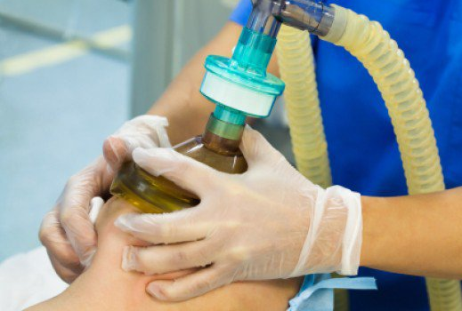
Connecting the Dots Before Sedation
Notes:
Most people think of their anesthesiologist /sedation provider only is only to keep the patient unconscious and pain-free during an procedure and who wakes them up when the operation is complete. Beyond this simple description of our job, we are the last line of defense for avoiding potential major complications

Slide 5
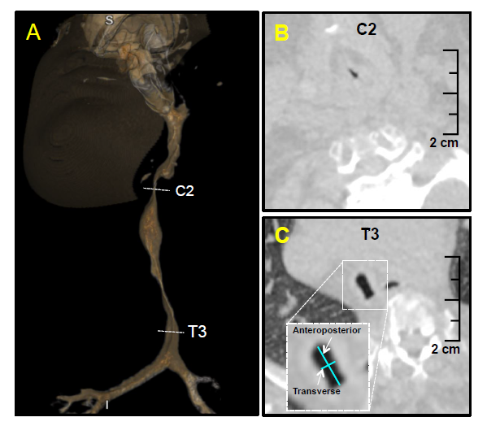
Connecting The Dots Before Sedation
Notes:
A 14-YR-OLD male with Morquio syndrome and complex airway anatomy presented for flexible bronchoscopy. Preoperative computed tomography with three-dimensional airway reconstruction revealed marked narrowing of the supraglottic and subglottic airway to 1.5 cm (solid and dashed arrows, image A). The trachea narrowed at C6 and remained in “saber-sheath” configuration for more than 5 cm to T3, with its center measuring 11 mm anteroposteriorly and 2 mm transversely.

Slide 6
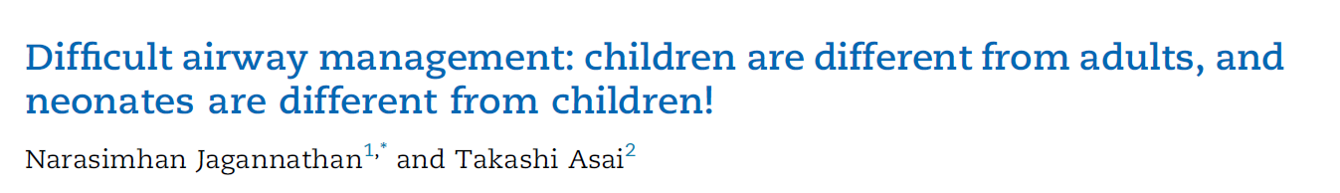
British Journal of Anesthesia, 126 (6): 1086e1088 (2021)
Notes:
European multicentre observational cohort study of critical events in paediatric anaesthesia. Difficult tracheal intubation, defined as two failed attempts of direct laryngoscopy, occurred at an incidence of 5.8%. In two-thirds of those patients, difficult intubation was unexpected. The most frequent interventions used to achieve a successful tracheal intubation were changing the laryngoscope blade and calling for experienced help. incidence of difficult tracheal intubation is higher in neonates and infants than in older children.2,4 Second, unexpected difficult intubation may occur more frequently

Slide 7
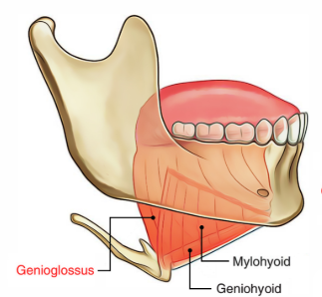
Natural sleep and Upper Airway Tone
Notes:
Upper airway patency depends on an appropriate balance between the dilating force of the pharyngeal muscles and the collapsing force of negative intraluminal pressure, which is generated by respiratory pump muscles. It is well accepted that maintenance of upper airway patency is a critical issue during sleep and sedation, because loss of consciousness may induce a depression of central respiratory output1–3 by altering hypercapnic and hypoxic ventilatory drives, and it may decrease muscle contractility via cellular mechanisms by blocking sarcolemmal sodium channels.4 Furthermore, it has been suggested that the neuromuscular activity of upper airway dilator muscles, such as the genioglossus and geniohyoid, may be affected by depression of hypoglossal motor neurons, which
regulate tonic activation of these muscles. These influences, in association with depression of consciousness during sleep nd sedation, may result in hypopnea and apnea due to upper airway obstruction

Slide 8
Effect of hypnotics and sedatives on upper airway
Benzodiazepines
Chloral hydrate
Ketamine
Barbiturates
Propofol
Dexmedetomidine
Opioids
Inhalational agents
Drug combinations
Notes:
Hypnotics and opioids decrease respiratory drive and place the upper airway at risk for collapse. Opioids are respiratory depressants and induce a dose-dependent impairment of upper airway dilator muscle activity1,2. Hypnotics and sedatives3–8, including propofol6,8, isoflurane7, thiopentone5, and midazolam9,10 predispose the upper airway to collapse, partly by decreasing upper airway muscle activity

Slide 9
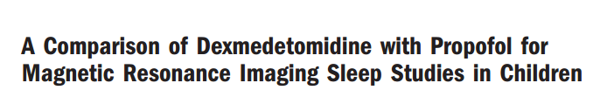
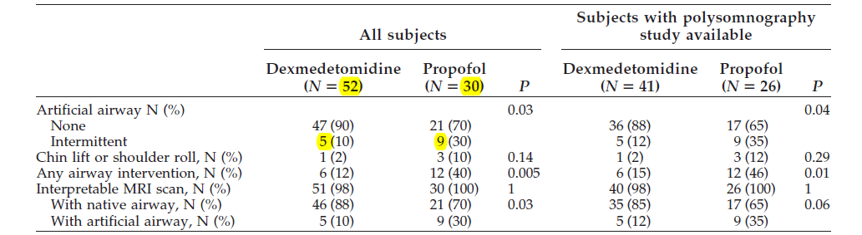
Mahmoud et al. Anesthesia Analgesia 2009 109: 745-753

Slide 10
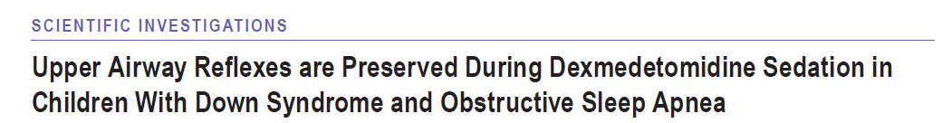
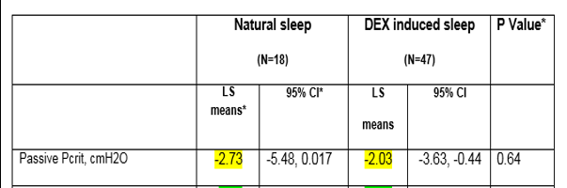
Mahmoud et al. Journal of clinical sleep medicine 2017 15;13(5):721-727

Slide 11
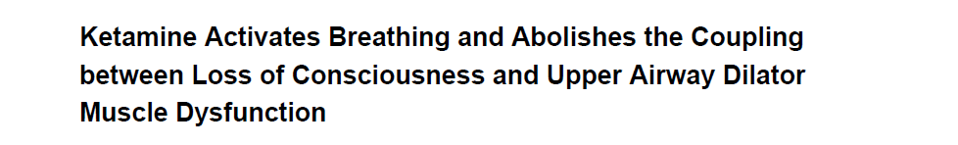
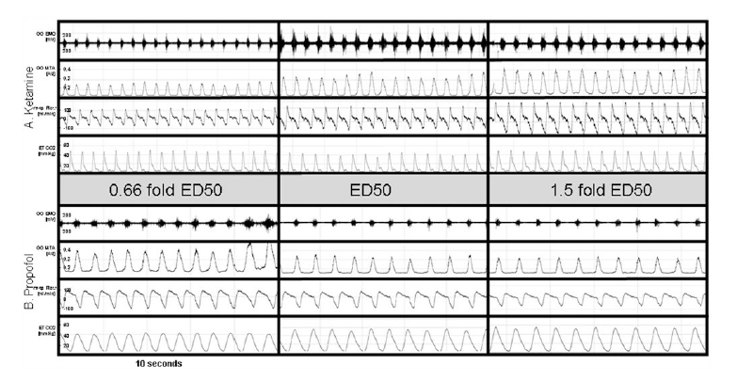
M Eikermann et al. Anesthesiology. 2012 January116(1): 35–46

Slide 12


Slide 13


Slide 14
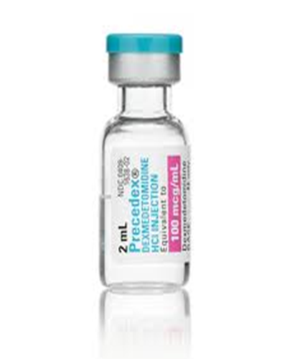

Dexmedetomidine and Ketamine for difficult airway
Dexmedetomidine
  Bradycardia
  Hypotension
  Decreases salivation
  Decreases emergence delirium
Ketamine
  Tachycardia
  Hypertension
  Salivation
Dex + Ketamine =
sedation + analgesia + hemodynamic stability
Notes:
Combo – sedation and analgesia and amnesia and hemodynamic stability
the combination of dexmedetomidine with ketamine makes pharmacologic sense as the two medications have the potential to balance the hemodynamic and adverse effects of the other. Additionally, ketamine as part of the sedation induction may speed the onset of sedation and eliminate the slow onset time when dexmedetomidine

Slide 15
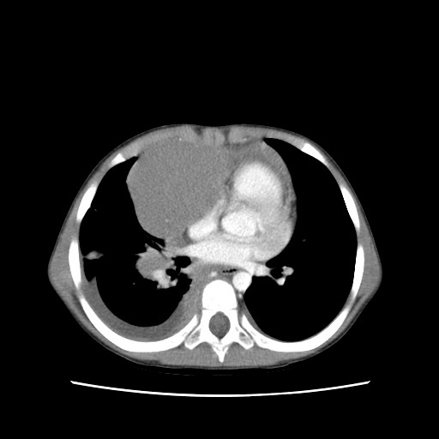
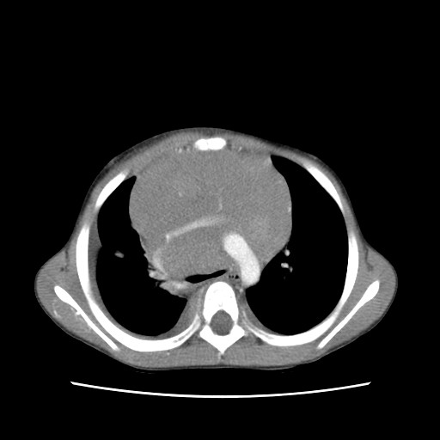
Dexmedetomidine and Ketamine for potential Airway catastrophe
Mahmoud et al. Pediatric Anesthesia 2008 18:1011-1013
Notes:
Dexmedetomidine may prevent the tachycardia, hypertension, salivation, and emergence phenomena from ketamine while ketamine may prevent the bradycardia and hypotension which has been reported with dexmedetomidine Additionally, ketamine as part of the sedation induction may speed the onset of sedation and eliminate the slow onset time when dexmedetomidine is used as the sole agent and the loading dose is administered over 10 min

Slide 16
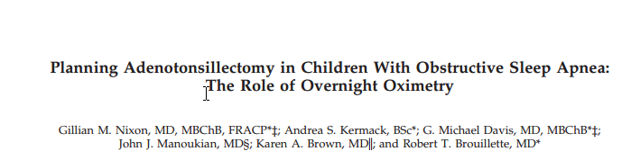
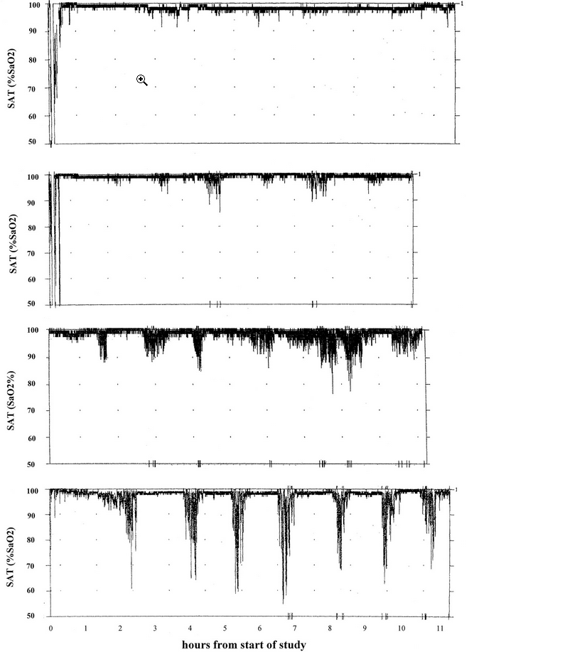
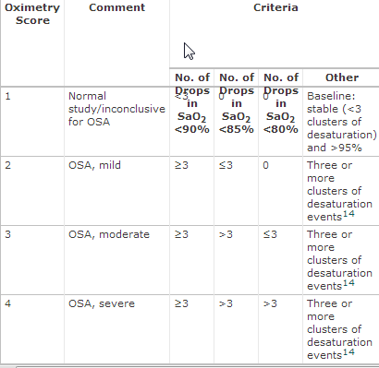

Precaution for Patients with OSA
Notes:
Readily available and relatively inexpensive The negative predictive value is 47%

Slide 17
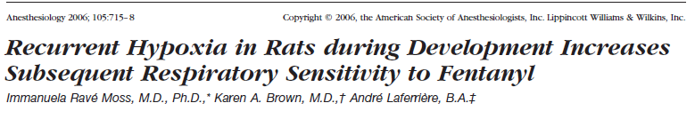
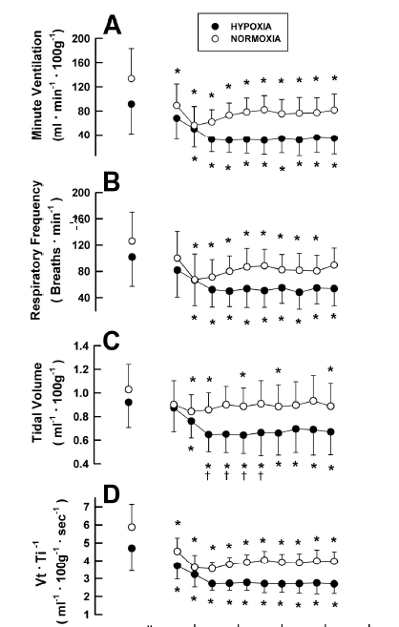
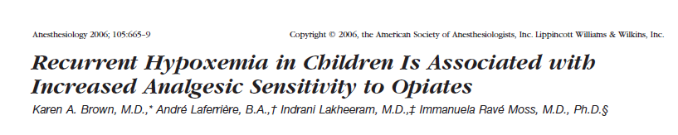
Notes:
As compared with controls, rats preexposed to recurrent hypoxia displayed a more profound depression with fentanyl in minute ventilation, respiratory frequency, tidal volume, and tidal volume divided by inspiratory time that represents respiratory drive. These results indicated an increased respiratory sensitivity to fentanyl after recurrent hypoxia. increased opioid sensitivity likely due to altered mu receptors from recurrent bouts of hypoxemia makes a normal dose of opioid a relative over dose in children with sleep apnea.
As compared with children in the > 85% group, the < 85% oxygen saturation nadir group required one half the total analgesic morphine dose postoperatively, indicating heightened analgesic sensitivity to morphine after recurrent hypoxemia.

Slide 18
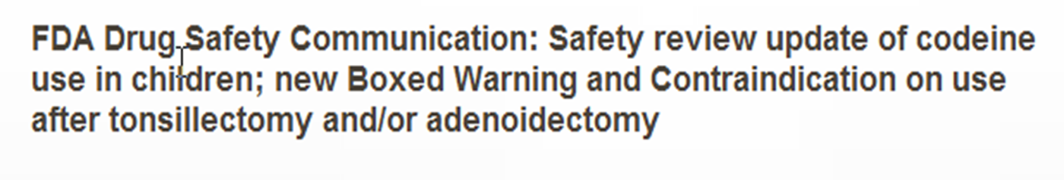
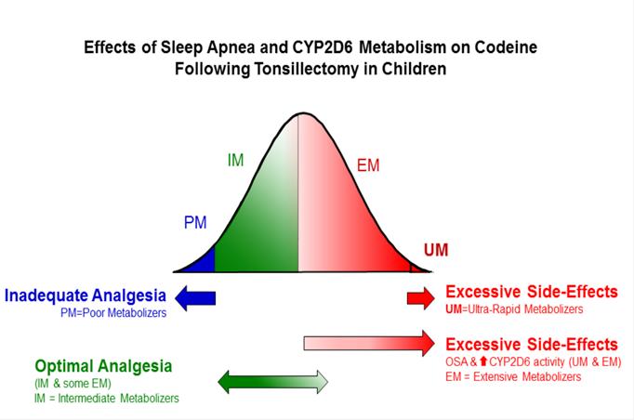
Codeine Related Adverse Effects
Notes:
standard" doses of oral codeine in children later found to be UM can be fatal

Slide 19
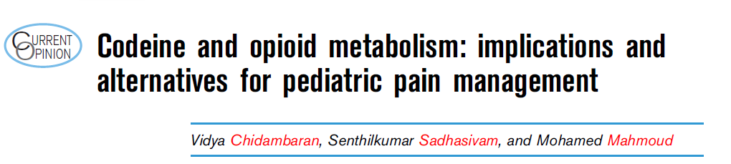
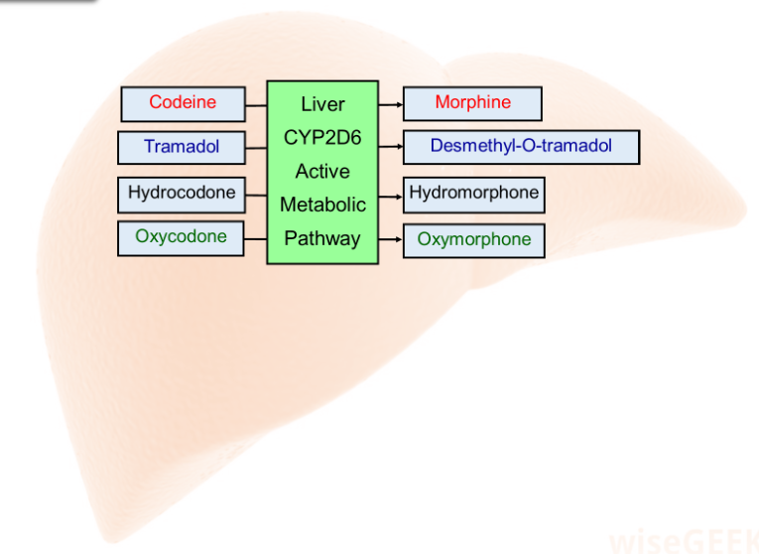
Curr Opin Anesthesiol 2017, 30:349–356
Notes:
Tramadol, oxycodone and hydrocodone are also metabolized by CYP2D6 similar to codeine [35]. Metabolites of hydrocodone and oxycodone from CYP2D6 pathway, hydromorphone and oxymorphone are about 5 and 14 times respectively more equipotent than morphine

Slide 20
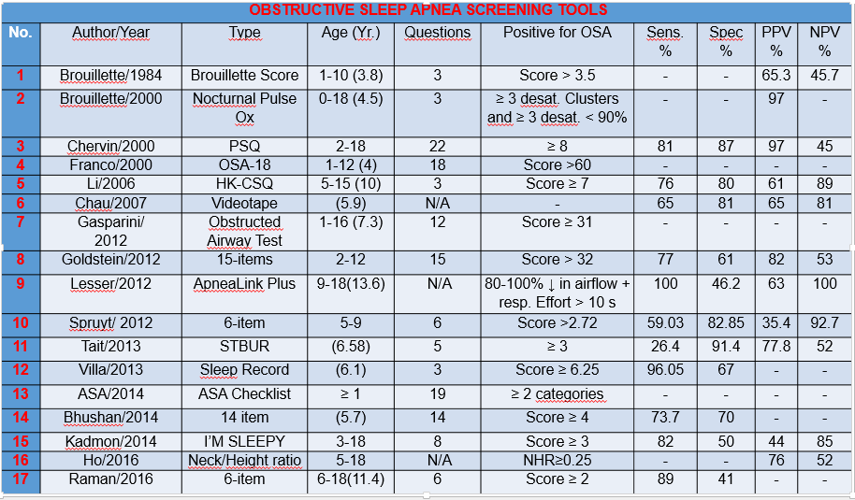
Diagnosis Dilemma

Slide 21
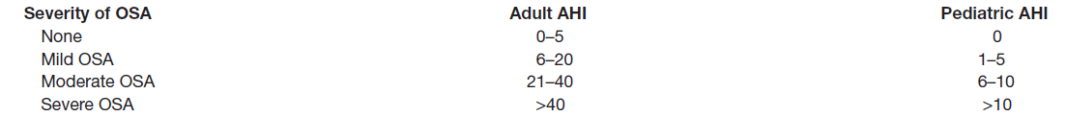
Diagnosis Dilemma

Slide 22
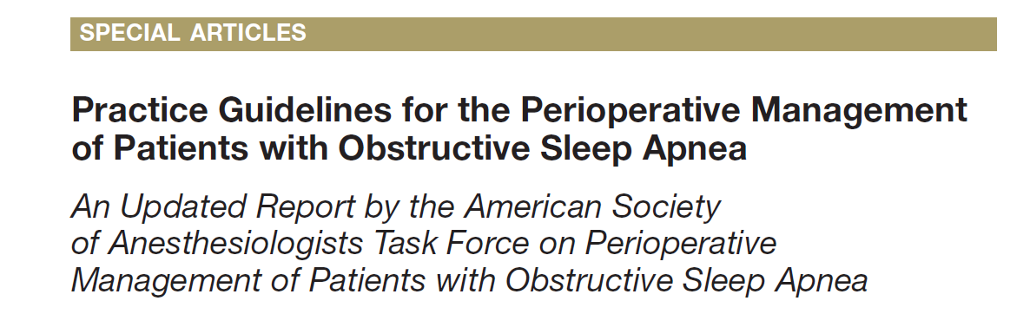
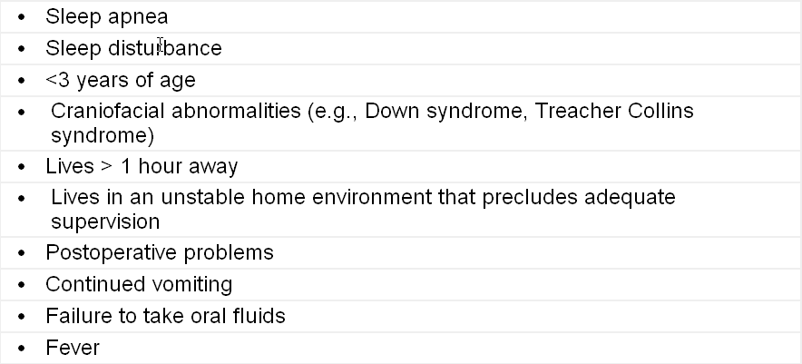
Discharge Dilemma
Notes:
Patients with score of 4 may be at increased perioperative risk from OSA; patients with a score of 5 or 6 may be at significantly increased perioperative risk from OSA

Slide 23
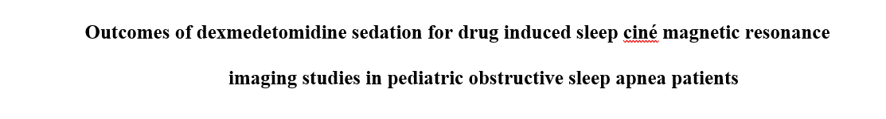
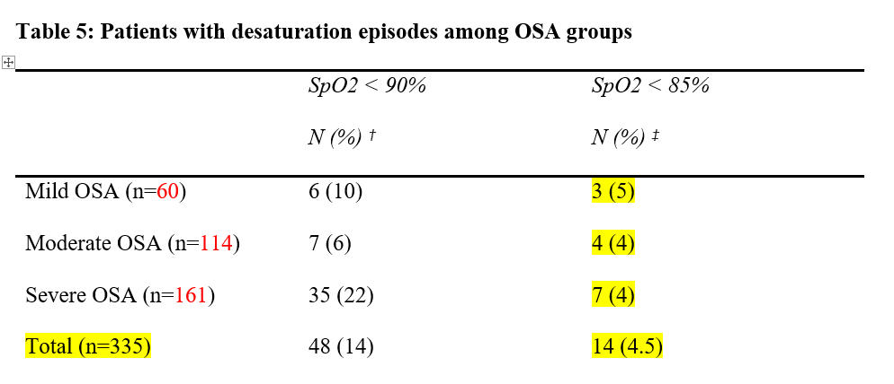
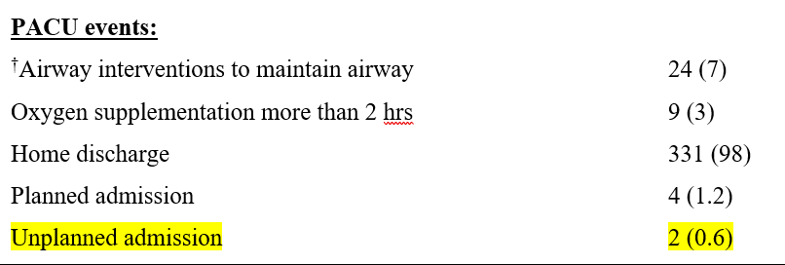
Suryakumar Narayanasamy et al Pediatric Anesthesia 2021;31:1241–1249

Slide 24
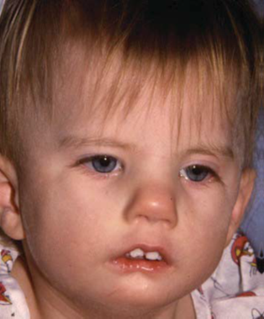
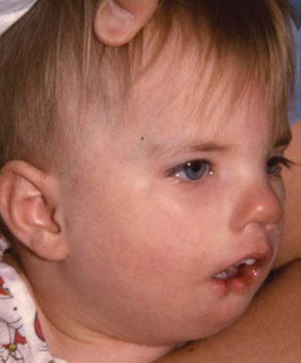

Airway Assessment
Prior difficult intubation
Prior head, neck, or oral surgery
Airway infection
Snoring
Specific Syndromes or diseases
Congenital Lesions
Laryngeal web, neck mass, hemangioma, subglottic stenosis, laryngomalacia
Careful history
Physical examination
Review medical records
Notes:
Recent upper airway respiratory infection predisposes to coughing, laryngospasm, bronchospasm, desat during sedation

Slide 25
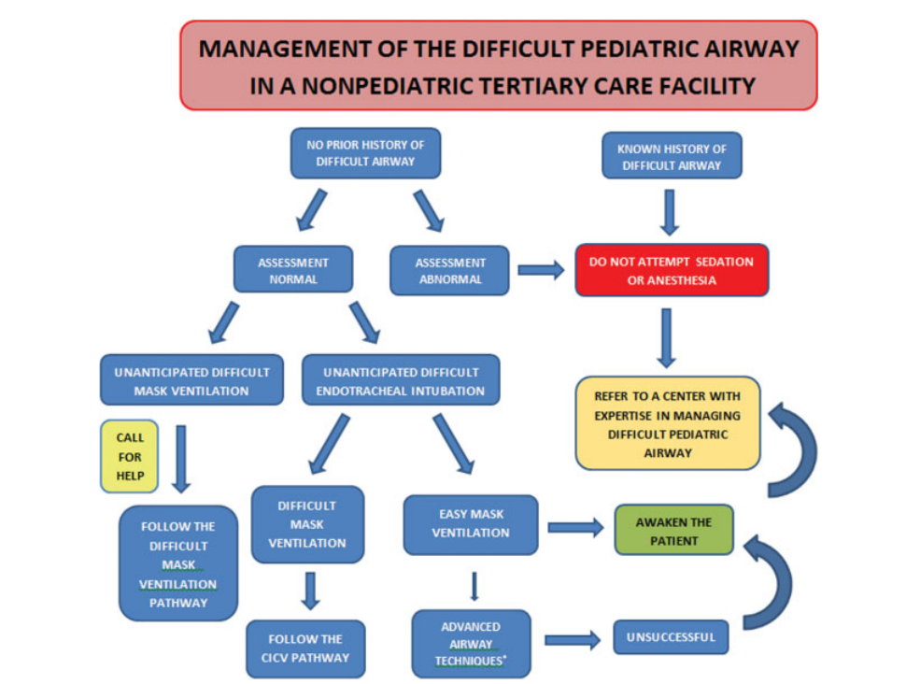
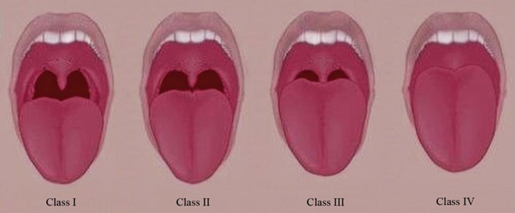
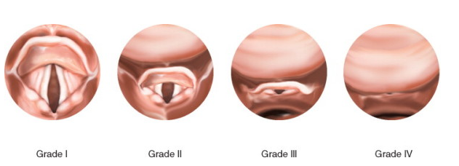
Why Documentation is Important?
Notes:
Postintubation Croup Incidence 0.1-1% Risk factors: large ETT, change in patient position introp, patient position other than supine, multiple attempts at intubation, traumatic intubation, pts ages 1-4, surgery >1hr, coughing on ETT, URI, h/o croup
Tx: humidified mist, nebulized racemic epinephrine, steroid
Laryngotracheal (Subglottic) Stenosis
Occurs in 90% of prolonged endotracheal intubation
Lower incidence in preterm infants and neonates due to relative immaturity of cricoid cartilage
Pathogenesis: ischemic injury secondary to lateral wall pressure from ETT edema, necrosis, and ulceration of mucosa, infx
Granulation tissues form within 48hrs leads to scarring and stenosis

Slide 26
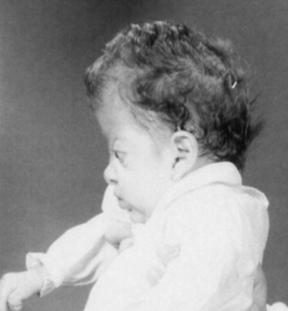
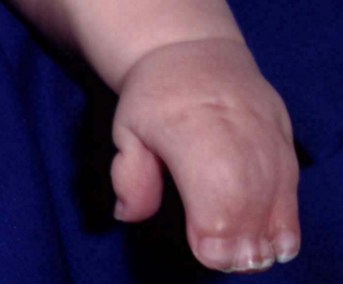
Apert Syndrome
Notes:
Apert syndrome
Features: Irregular premature fusion of multiple cranial sutures Midface hypoplasia/hypertelorism Syndactyly Possible choanal stenosis
Progressive calcification of hands, feet and cervical spine 10% incidence of cardiac defects/genitourinary anomalies Bag mask ventilation may be difficult but intubation is usually straightforward. A smaller size endotracheal tube may be required

Slide 27
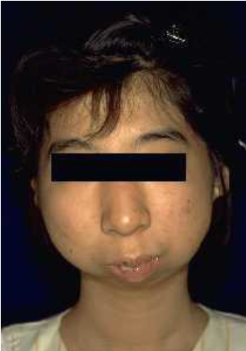
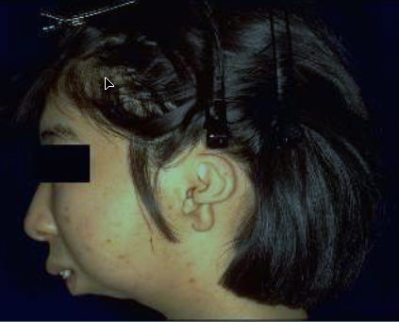
Goldenhar Syndrome
Notes:
Hemifacial microsomia is a rare congenitally acquired dentofacial deformity characterized by unilateral hypoplasia of the hard and soft tissues of the face and cranium. Associated anomalies of the vertebrae and hypopharynx cause perioperative airway management to be difficult. The case of a patient with severe heimfacial macrosomia. limitation of neck movement resulting from vertebral anomalies

Slide 28
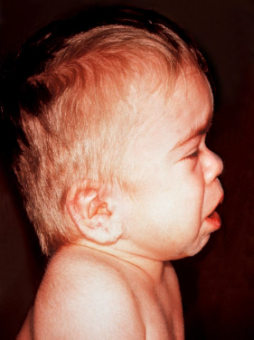
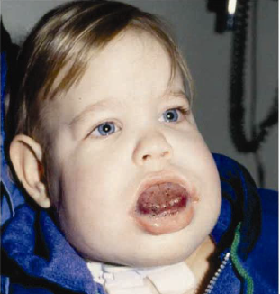

Hurler’s Syndrome
Notes:
Lysosomal enzyme deficiency and accumulation of glycosaminoglycans. Specific airway involvement can manifest as a narrowed nasal passages, large tongue, adenotonsillar hypertrophy, short and immobile neck, high epiglottis, hypoplastic mandible with short ramus, and thickened glottis/supraglottis. The head is enlarged with characteristic coarse facial features, hypertelorism, flattened nasal dorsum and peg-like teeth. Cervical spine instability may occasionally be seen in Hurler's syndrome. These abnormalities, along with excessive secretions, stiff temporo-mandibular joints and anteriorly placed larynx may cause mask ventilation and endotracheal intubation extremely difficult.

Slide 29
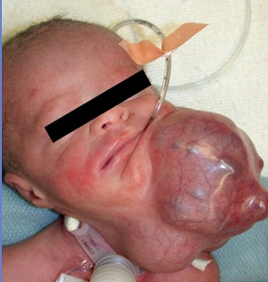
Congenital Neck Masses
Notes:
The one on the right side is cystic teratoma talk about EXIT

Slide 30
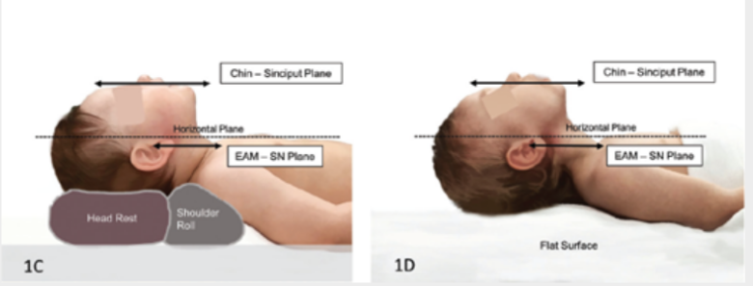
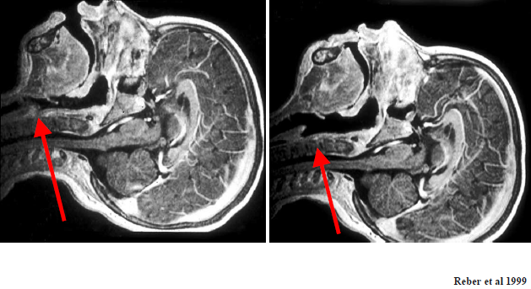
Chin Lift

Slide 31
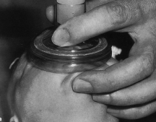
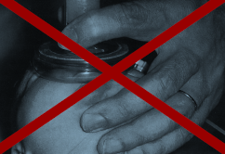
Chin Lift
Notes:
One other important anatomic difference related to management of the pediatric airway actually relates to the pediatric gastrointestinal tract. Pediatric patients are much more susceptible to gastric distention during positive pressure ventilation. Pediatric patients are less able to tolerate gastric distention due to their smaller lung volumes and their dependence on the diaphragm for respiration. Therefore, the pediatric patient should be ventilated with smaller pressures in an effort to minimize gastric inflation. Decompression of the distended stomach will significantly improve the respiratory mechanics and should routinely be performed on any child who has received positive pressure ventilation.

Slide 32
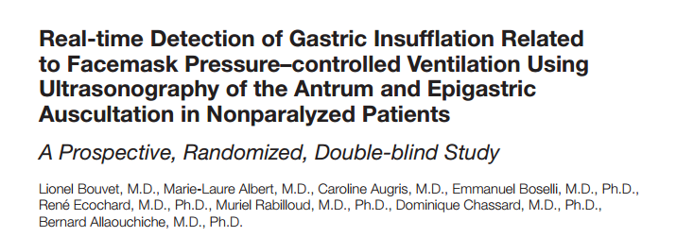
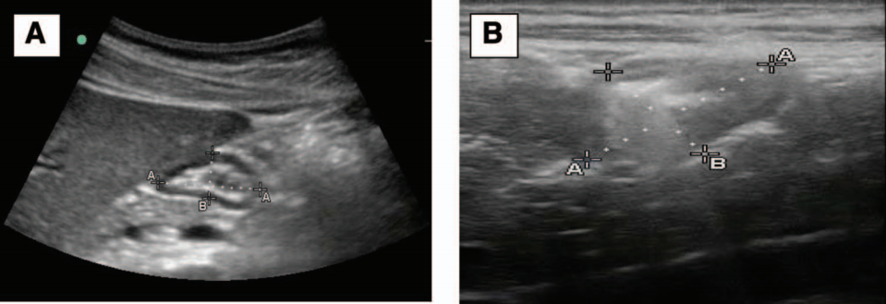
(Anesthesiology 2014; 120:326-34)
Notes:
Inspiratory pressure of 15 cm H2 O allowed for reduced occurrence of gastric insufflation with proper lung ventilation during induction of anesthesia with remifentanil and propofol in nonparalyzed and nonobese patients.

Slide 33
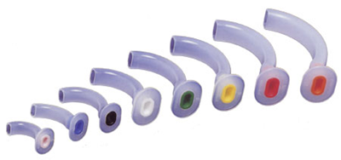
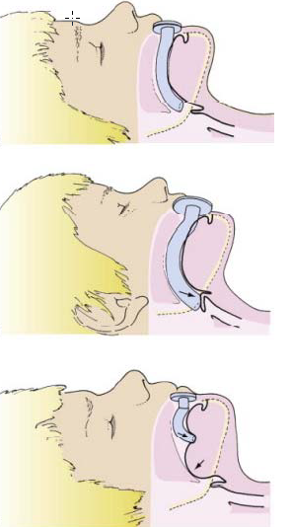
Oral Airway Intervention
Notes:
An infant’s tongue is relatively large and often obstructs the oropharyngeal airway during induction of anesthesia or loss of consciousness. It is important, therefore, to position the child correctly and select the appropriate size oropharyngeal airway.

Slide 34

Nasal Airway Intervention
Notes:
Lightly anesthetized patients may tolerate the nasal airway better than an oral airway; however, insertion of the nasopharyngeal airway is often avoided in the presence of hypertrophied adenoid tissue because of the increase incidence of bleeding and trauma. Nasopharyngeal airways are available in sizes 12F to 36F.

Slide 35


Intubating Laryngeal Airway (air‐Q )
Notes:
intra‐cuff pressure of
40 cmH2O associated with:
1. Better leak pressures
2. Less post‐op sore throat

Slide 36




Slide 37
Golden Rule
Do not continue to do the same thing and expect a different result
Notes:
Ensure that all equipment is at hand and checked
Get good assistance
Plan ahead, and have plans A, B, C, D of what to do if things go wrong
Do not be afraid to wake up or proceed with a surgical airway if necessary

Slide 38

Can not Ventilate with LMA

Slide 39


Extubation of the Difficult Airway

Slide 40
What is the Single Best sedative Technique for Airway Catastrophe?
None
Evaluation
Titration
Communication
Notes:
The anesthetic technique in these patients must be tailored to the underlying etiology, OSA severity, and surgical procedure
SDB may be underdiagnosed and unrecognized. high index of suspicion, detailed clinical history, and physical examination

Slide 41



Connecting the Dots before Sedation
More Complex Procedures
Sicker Patients
Notes:
We are constantly working with the rising cost of health care. We are being asked what we can do to reduce cost while at the same time improve efficiency and quality
In addition, we continue to face new drug shortages – many because it is no longer profitable for companies to produce…bicarb, succinylcholine, epinephrine, fentanyl, morphine, ketamine, and now lidocaine…which means …
Reevaluate how to deliver safe anesthesia
These two challenges have lead us to exponentially increasing our use of dexmedetominde.
The primary focus of my practice is with children; however, I will reference both peds and adults.

Slide 42
Thank You!

