Slide 1
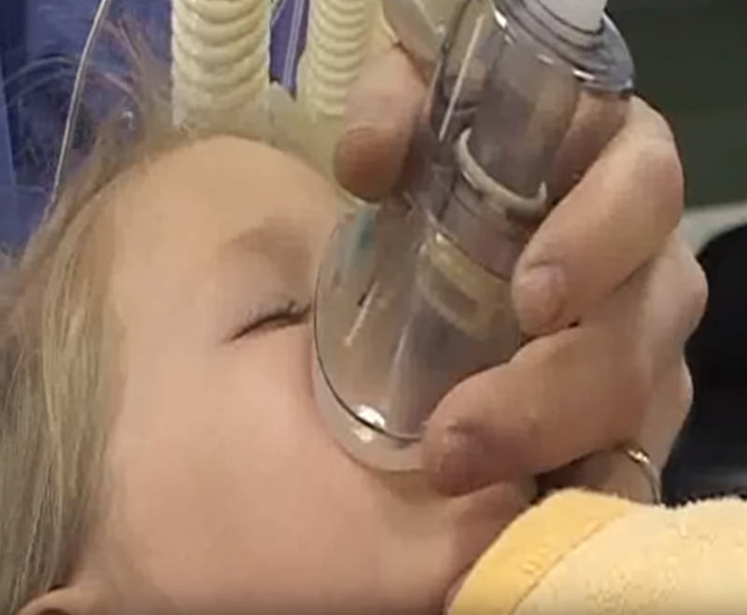
Keeping Nitrous Oxide safe for all
Solutions for controlling occupational exposure
Zita Kolder, Occupational Hygienist, ROH, Erasmus MC
Hendrik Jan Jansen, Occupational Hygienist, Amsterdam UMC
Notes:
Also on behalf of my colleague Henkdrik Jan I want to welcome you to this workshop : Keeping nitrous oxide safe for all.
My name is Zita Kolder, I work as an occupational hygienist at the Health and Safety department of the Erasmus MC Medical Center in Rotterdam, here in the Netherlands. In my work I am particularly focused on the health and safety of our employees. I have been involved in the elimination of nitrous oxide at our animal experiment center and the introduction of nitrous oxide during deliveries at our Birth Center. This year I am involved in the introduction of nitrous oxide to children for pain and anxiety relief.
Hendrik-Jan ………………………………….
Nitrous oxide is used to reduce pain- and anxiety, for example by dentists, midwifes and it is gaining polularity in emergency rooms and pediatrics care.
We will not be talking about patients but about the health and safety for yourself and fellow employees, because nitrous oxide should be handled with care.
Our goal is to discuss solutions for controlling your occupational exposure.

Slide 2
Welcome
Anesthesiologist
Nurse
Pediatrician
Pediatric Oncology Nurse
Sweden
Germany
Denmark
Neonatologist Pediatrician
Physician
Switzerland
Belgium
Emergency Physician
Physician Assistant
the Netherlands
Indonesia
Sedation Practice Specialist
MPZ/Child Life Specialist
Global Product Manager
Occupational Hygienist
Notes:
According to the information we have received, all the people gathered in this room represent a variety of professions from seven different countries.
We are happy to see such a diversity because this gives us the opportunity to share knowledge and experience.

Slide 3
Program Keeping Nitrous Oxide safe for all
Introduction
Nitrous oxide: Health effect and pregnancy
3. Factors that determine the concentration of N₂O in the work environment
4. Theory of Hierarchy of control
Exercise 1: Control measures at work
Exercise 2: Control measures to minimize the exposure to nitrous oxide for HCW
4. Summary and conclusion
Notes:
This is our program.
We will start with an introduction to get to know each other.
After that Hendrik-Jan will tell us about the health effects of nitrous oxide for employees in general and for pregnant employees in particular.
Next we will discuss the factors that determine the concentration of nitrous oxide in the work environment.
Next Hendrik-Jan will tell us about The Theory of Hierarchy of control, this is a strategy to establish preventive measures at the workplace.
Afterwards there will be two exercises.

Slide 4
1. Introduction
Do you have a question in advance?
Notes:
Before we start we are curious about your experience with nitrous oxide:
Who does administer nitrous oxide on a daily base?
What are your experiences with nitrous oxide?
What are your expectations of this workshop?
Do you have questions in advance?
2. Who does not administer nitrous oxide?
What are your experiences with nitrous oxide?
What are your expectations of this workshop?
Do you have questions in advance?
3. Others who have questions in advance?

Slide 5
2. Health effects and pregnancy
Acute effects of nitrous oxide:
Drowsiness
Dizziness
Euforia
Intoxication

Slide 6
2. Health effects and pregnancy
Long term health effects of Nitrous Oxide
Inactivation B12
Neurological failure
Increased chance on cardiac and vascular disease
Anemia
Reprotoxic effects (Dutch Health Council 2000)
Possible decrease in fertility
Possible increase in birth defects and termination of pregnancy
Based on animal studies
Indications that peak exposure increases risks

Slide 7
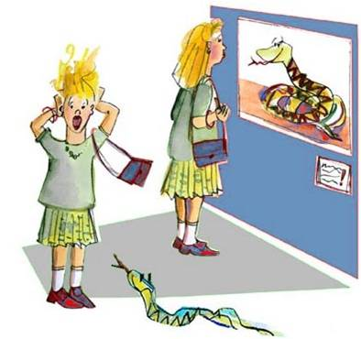
2. Health risk
Hazard ≠ Risk
Hazard + Exposure = Health Risk

Slide 8
2. Occupational Exposure Limits
Country | TWA 8 hours (mg/m³) | TWA 15 min (mg/m³) | Year
The Netherlands | 152 |  | 1992
Germany | 180 | 360 | 2009 2019
Sweden | 180 | 900 | 2005 2018
Austria | 180 | 720 | 2007
Danmark/Norway/ Belgium/Spain | 90-92 |  | 2007
USA | 98 |  | 2020
Notes:
Omrekenfactor 1 mg/m3 = 0,545 PPM

Slide 9
Question?
Which factors determine the concentration of N₂O in the working environment?

Slide 10
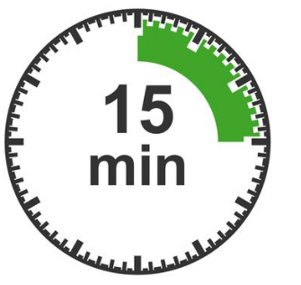
Factors that determine the concentration of N₂O in the work environment
1. Concentration N₂O in the mixture
2. Duration of administration
O₂
O₂
OR
OR
N₂O
N₂O
Notes:
In the gas cylinders that are used the concentration nitrous oxide is 50% in the mixture with oxygen.
The lower the concentration nitrous oxide in the mixture the lower the concentration in the working environment.
Diminishing the concentration nitrous oxide for administration can be done by titrating. Dentists use this and we have seen it in pediatrics.
The second factor is time.
First of al the duration of administration
But of course also the number of administrations on a day determine the concentration in the work environment.
A 50% nitrous oxide in oxygen mixture is commonly used as an analgesic. But there is technical equipment that can titrate and can lower the concentration for example with 15% to 35% nitrous oxide.

Slide 11
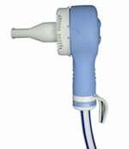
Factors that determine the concentration of N₂O in the work environment
3. Flow
4. Method of administration N₂O
Continuously
On-demand
OR

Slide 12
Factors that determine the concentration of N₂O in the work environment
5. The extent of leakage
fit of administration mask to face
amount of exhaled air from the patient entering the room
design and maintenance of the equipment (e.g. connections)
how well the patient is instructed
guidance of patient
patient behavior (e.g. coughing, anxiety, restless)
amount of distraction (both patient and employee)

Slide 13
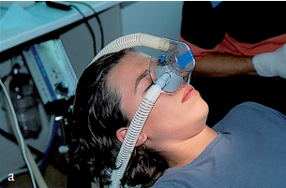
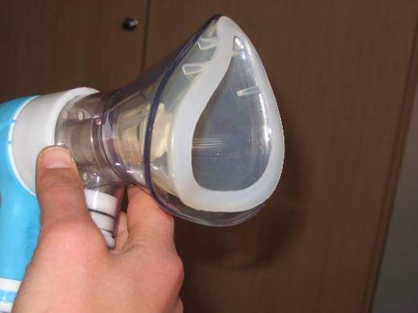
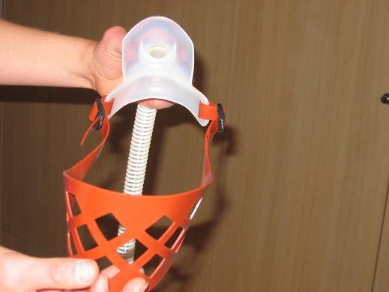
Factors that determine the concentration of N₂O in the work environment
6. Extraction at the source
extraction during administration
extraction of exhaled air
Double mask
Chin mask
Notes:
Here we see a technical measure that influences the exposure of the employee. A double mask or a chin mask reduce occupational exposure for staff.

Slide 14
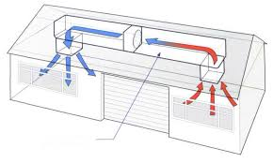
Factors that determine the concentration of N₂O in the work environment
7. Ventilation rate in the room > 5

Slide 15
3. Hierarchy of Controls

Slide 16
Exercise 1:
Which control measures can you mention in your daily work?
Physical strain
Infection prevention for health care worker

Slide 17
Exercise 1:
Which control measures can you mention in your daily work?
Physical strain
Infection prevention for health care worker

Slide 18
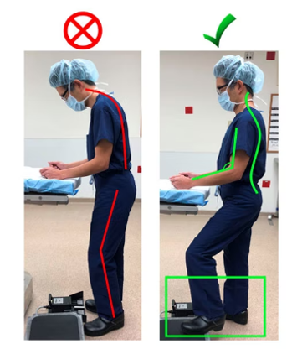
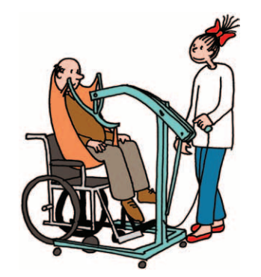
Fysical strain
Coaching on the job
Source: LocoMotion
Source: Daniel L. Wohl, MD and Theresa Hubbard, DPT for the PSQI Committee
Notes:
These are examples of control measures to prevent fysical strian.
An example of an engineering control measure are tools for example like elevators at the nursery.
Height adjustability of furniture is also an engineering control measure.
An example of an administrative control measure is coaching on the job.
Being alert of the ergonomic posture of your body in different work situations.

Slide 19
Exercise 1:
Which control measures can you mention in your daily work?
Physical strain
Infection prevention for health care worker

Slide 20
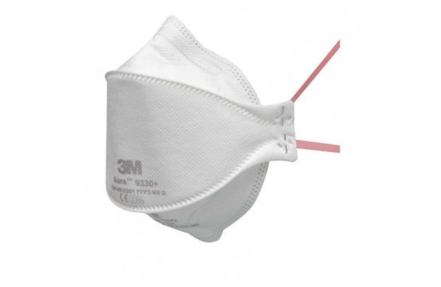
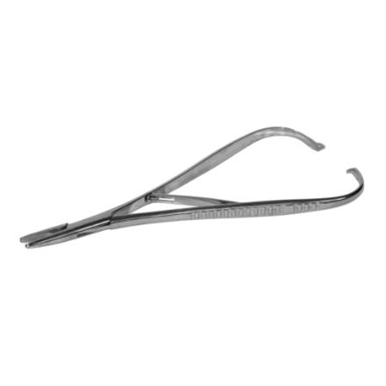
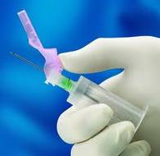
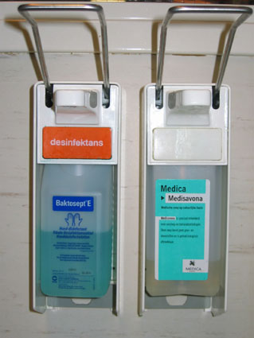
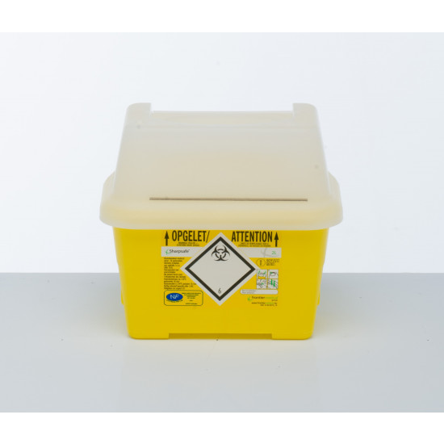
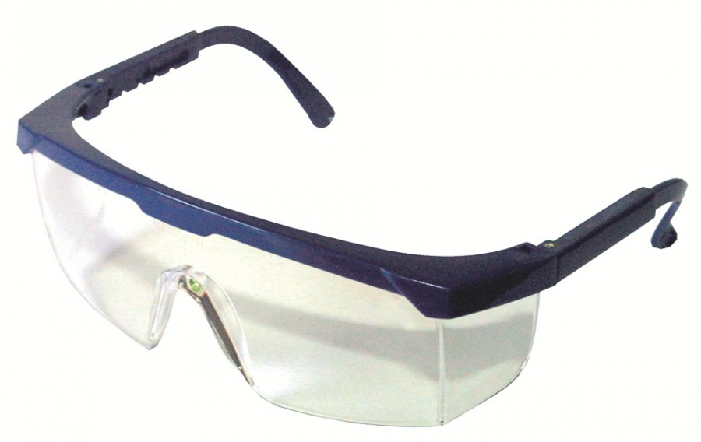
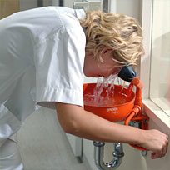
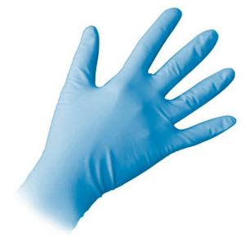
Infection risk
Reporting procedure for needlestick-injuries
Vaccination
Notes:
To prevent needle stick injuries.
A engineering control measure are needles with a safety system and sharp boxes and the personal protection equipment.
Administrative controls are the organisation of vaccination of employees and the availability of enough PPM.

Slide 21
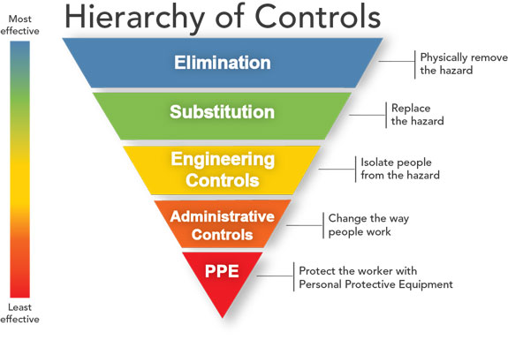
Exercise 2:
Which control measures minimize the exposure to nitrous oxide for HCW during administration?
To which step in the Hierarchy of Control does this measure belong?

Slide 22
Exercise 2: Control measures N₂O
Elimination or subtitution
Using VR instead of N₂O Emla Hypnotic therapie Use of pain medication Sevofluraan

Slide 23
Exercise 2: Control measures N₂O
Engineering control
Design Titration of concentration N₂O On demand valve Masks with different sizes Double mask Chin mask Local exhaust Ventilation rate > 5

Slide 24
Exercise 2: Control measures N₂O
Administrative control
Protocol Training Reporting procedure for incidents Availability of different mask sizes Measurement of exposure N₂O Supervision on following the protocol Quiet environment (no light, no noise) Checking pain score Maintenance administration delivery system Instruction and guidance patient Responsible person for the rooms

Slide 25
4. Questions and conclusion
Nitrous oxide: Health effect and pregnancy
2. Factors that determine the concentration of N₂O in the work environment
3. Theory of Hierarchy of control
Exercise 1: Control measures at work
Exercise 2: Control measures to minimize the exposure to nitrous oxide for HCW

Slide 26
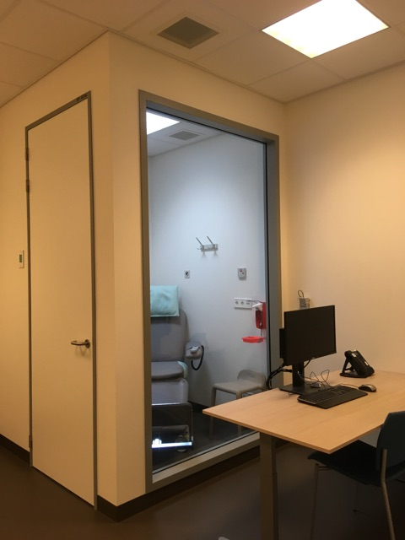
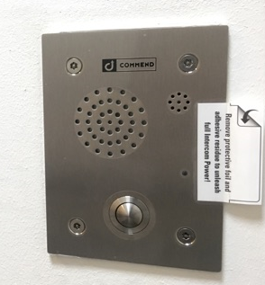
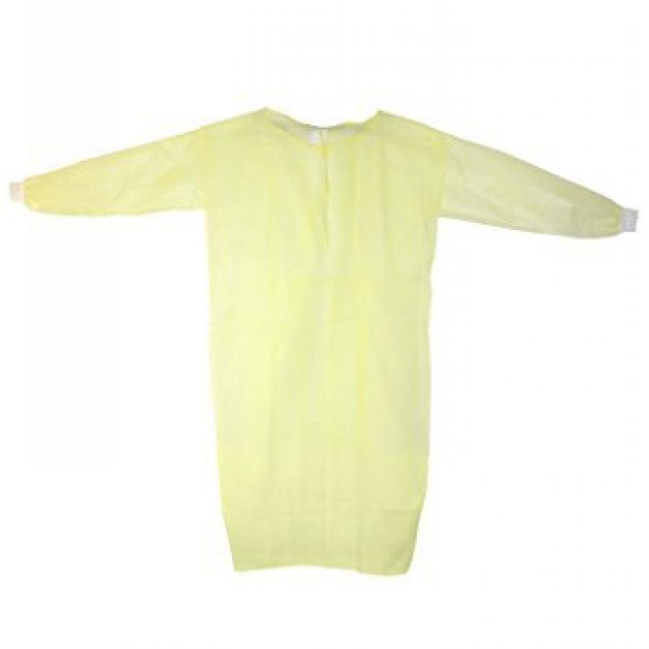
Nebulizing medicines
Breath activated nebulizer
Instruction patient
Filter for exhaled breath
No other persons in the room
Cabin for Pentamidine

